Slide 2
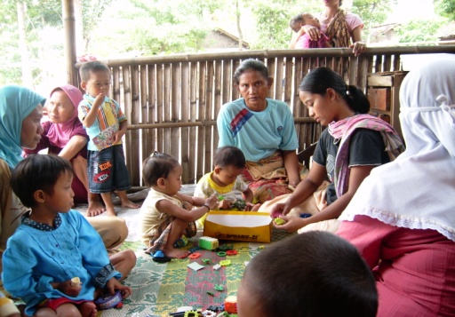
POSITIVE DEVIANCE APPROACH IN NUTRITION 7th session DESIGN
Diah M. Utari
Department of Public Health Nutrition
Faculty of Public Health
Universitas Indonesia

Slide 3
STUDY OBJECTIVES
01
02
Behavior changes
To create a design

Slide 4
Behavior changes ???
Behavior : The process of action – reaction between stimulus and response that received by individuals and the environment, such as other individuals, groups, and environment
Behavior changes : In applying the PD concept, the key to success is implementing behavioral practices become habits
http://clipart-library.com/search2/?q=consumption#gsc.t ab=1&gsc.q=consumption&gsc.page=1

Slide 5
Design
Design = local specific
Pos Gizi
It is a gathering place for malnourished children and caregivers (mother/father/grandmother) to practice PD behavior obtained based on tracing the discover stage
The objective of POS GIZI are
- Improve nutritional status
- Maintain good nutritional status
- Prevent the occurrence of malnourished
Sumber: PDRC

Slide 6
Pos Gizi Implementation session
Posyandu
P O S G I Z I
Home visit
1
5
7
18
30
days
1 session = 1 month
10-12 days POS GIZI in 1 month
Behavior → Habit (Minimal 3 session or 3 month)

Slide 7
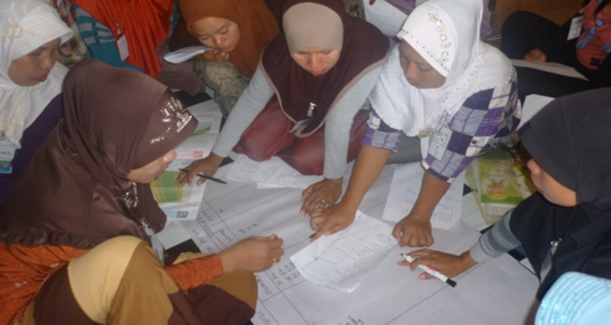
Aggrement to open the Pos Gizi
• The time to open the Pos gizi is agreed upon by the mother or others caregivers for children participating in pos gizi
• Not allowed during mealtime, but between meals
• Could be around: 9am in the morning or 3pm in the evening
• The location of the Pos Gizi was agreed upon by the participants,
• The place must have a kitchen and can accommodate 6 -12 children

Slide 8
Participant criteria
• Children under five are malnourished
over 1 year old.
Body weight doestn’t gain for 3 months
Do not suffer from chronic disease
Economic status is not a criterion,

Slide 9
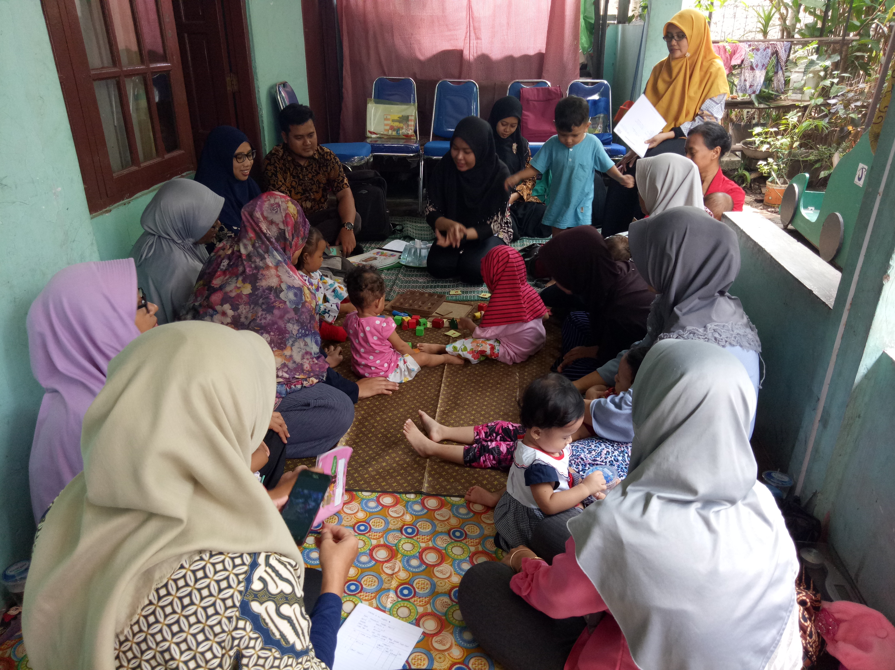
Pos Gizi Activities
Taking attendance
Food contribution
Cooking
Playing
Health messages
Washing hands
Eating together
Planning meals for tomorrow and contributions
Recording and reporting
Dokumentasi oleh PDRC FKM UI

Slide 10
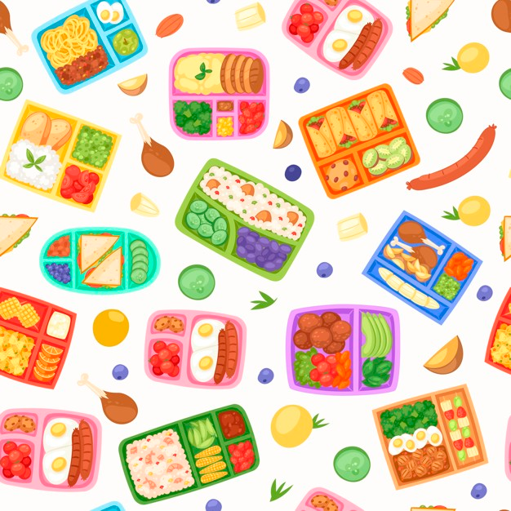
Meals
Main food
carbohidrat, protein, vitamin and mineral
Rice, egg/fish/chichen, tempeh, vegetables, fruit
Nutrient :
400 – 600 Cal
20 – 25 gram protein
https://www.freepik.com/premium-vector/lunch-boxes-with-food-seamless-pattern_5696103.htm#page=2&query=school+meals&position=3

Slide 11
Reference
Review
Design harus di buat agar masyarakat bisa meniru hal baik sehingga perilaku yang dipelajari berubah menjadi kebiasaan
Tugas
Membuat design berdasar skenario
Notes:
This is our reference

Slide 12
VIDEO BANTUAN DANA MATA KULIAH MOOCs DPASDP UI 2020
Copyright @ Universitas Indonesia 2020
Produksi S1 Gizi, FKM UI

