Slide 1
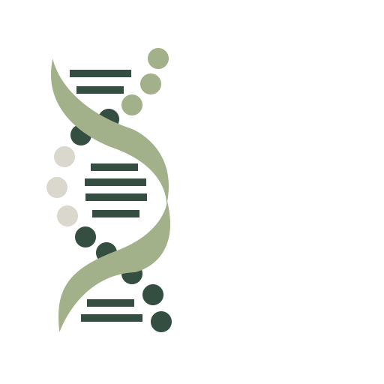
BIOINFORMATICS IN
BIOLOGICAL DATA EXPLOTION
MK BIOENGINEERING
Program Doktor Ilmu Biomedik
Fakultas Kedokteran
Universitas Indonesia
2020
Pengenalan Bioinformatika

Slide 2
BIG DATA : DATA GENOMIK
1000 petabytes = 1million terabytes = 1billion gigabytes
Stephens ZD, Lee SY, Faghri F, Campbell RH, et al. (2015) Big Data: Astronomical or Genomical? PLoS Biol 13(7): e1002195.

Slide 3
Gene Finding, Comparative genomics, DNA methylation
Differential expression
Co-expression
ncRNA
Mass spec protein identification
Structure prediction/
alignment
Sequence alignment, Database similarity search, Motif finding
DNA
RNA
PROTEIN
PHENOTYPE
GENOTYPE
MOLECULAR NETWORKS
CELLS
PHYSIOLOGY/DISEASE
Protein interaction networks, Transcriptional regulation networks, metabolic signaling networks
Virtual cell simulation
Population genetics, Human
Genetics
THE BIOLOGY IN BIOINFORMATICS

Slide 4
Database, Ontologies, Metadata
Algorithms, Software tools, Webservers
Biological discoveries
Predictive models, System simulation
DATA MANAGEMENT
DATA COMPUTATION
DATA MINING
MODELING & SIMULATION
DATA
DISCOVERY
THE INFORMATICS IN BIOINFORMATICS

Slide 5
Technology
as technology
Methods
as methodology
BIOINFORMATICS
An interdisciplinary fields that develops and applies computer and computational technologies to study biomedical questions
Technology as a technology, bioinformatics is a powerful technology to manage, query, and analyse big data in life science.
Methode as a methodology,
Notes:
Technology
bioinformatics is a powerful technology to manage, query, and analyse big data in life science
Methods
bioinformatics is a top-down, holistic, data driven, genome-wide, and systems approach that generates new hypotheses, finds new pattern, and discover new functional elements.

Slide 6
REQUIREMENT FOR THE METHODS
Efficient storage system
Efficient algorithms
Scalable
Accurate
integrative
HIGH THROUGHPUT DATA
Huge amount
Explosive growth
Low signal-noise ratio
Multiple type
OPPORTUNITIES AND CHALLENGES
the driving forces of bioinformatics

Slide 7
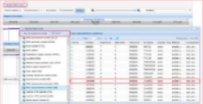
BIOINFORMATICS WORKFLOW MANAGEMENT SYSTEMS
MULTI-OMICS SCORING ENGINE (MOSE)
MULTI-OMICS VARIANT ANALYSIS (MOVA)
APPLICATION
Diagnostics
Genetic disease, hereditary syndrome
Cancer Treatment
Early detection, prognostic, treatment, monitoring
Prediposition & Prognostics
Chronic disease, lifestyle, complications
Pharmacogenomics
Metabolism, response, adverse reactions
Infertility and IVF
NIPT, oocyte arrest, implantation failure
Variant prioritization and genes damage scoring using proprietary algorithm
Signaling, regulatory, interaction networks
Functional Analysis
And Visualisation
5 most used: TGex, VEP, Babelomics, FAV, Golden helix
Knowledge database
Suwinski P., 2017

Slide 8
BIOLOGICAL SEQUENCING: Application in health
Shyr, D., Liu, Q. 2013. Next generation sequencing in cancer research and clinical application. Biological Procedures Online201315:4

Slide 9
INTEGRATED NETWORK SYSTEM
AIMS
Biological
Networks
Annotation
Networks
Interception of OMICS data
Drug development & repositioning
Inferring novel gene functions
Understanding genome-phenome
Network
Analysis
Network
Visualization
Integrative
Analysis

Slide 10
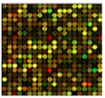
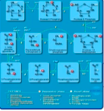
INTERPRETING GENE LIST
Ranking or clustering
Analysis tool
Prior knowledge about cellular process
Eureka!
New heart disease gene!
My cool new screen worked and produced 1000 hits… now what?
Genome scale analysis (omics) → genomic, proteomics
Tell me what’s interesting about these gene → are they enriched in known pathway, complexes, function

Slide 11
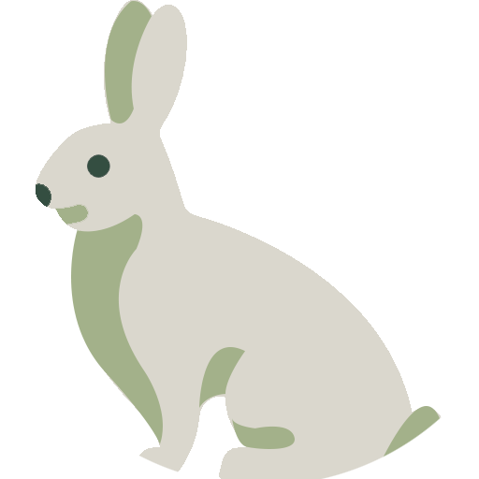
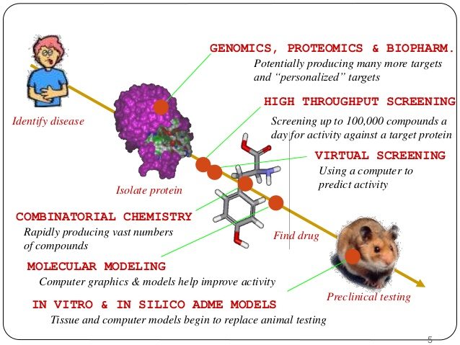
Bioinformatics techniques are also used in the process of drug discovery, THESE SPEEDS UP THE PROCESS
Genomics, proteomics, and biopharma
High throughput screening
Combinatorial chemisty
Molecular modeling
In vitro
In silico
ADME model
Identify disease
Isolate protein
Find drug
Preclinical testing

Slide 12
THANKYOU
REFERENCES
Arthur M Lesk (2014). Introduction to bioinformatics. Oxford University Press. Oxford, United Kingdom
Tringe SG, Hugenholtz P (2008) A renaissance for the pioneering 16S rRNA gene. Curr Opin Microbiol 11: 442–446.

