Slide 2
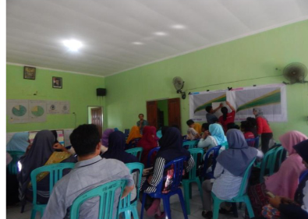
POSITIVE DEVIANCE APPROACH IN NUTRITION 8th session
Village Community Meeting (VCM)
(Musyawarah Masyarakat Desa)
Diah M. Utari
Department of Public Health Nutrition
Faculty of Public Health
Universitas Indonesia

Slide 3
STUDY OBJECTIVES
01
02
03
Objectives
Target
Implementation strategy

Slide 4
Objectives
Village Community Meeting (VCM) : forum for meetings at the village level for discussions to solve various community problems
01
Objectives
Community know about malnutrition problems in children under five in their villages
Find a agreement, so that the problem can be solved by theirself without waiting for help from others
The community can learn from their successful neighbors; poor families who have well-nourished children
they have unique behaviors so that they do not experience problems as most of community

Slide 5
Target
02
Village officials
Public figure
Religious leaders
Health workers
Cadres
Mother of children under five
Fathers of children under five
And others

Slide 6
Implementation Strategy
STEP 1
STEP 3
STE2
STEP 4
03
STEP 5
Opening
Solution
Community support
STEP 6
Posyandu Data (KMS, pie diagram, SKDN block)
Agreement to resolve the problem
Closing

Slide 7
Discussion Role play of Village Comunity Meeting

Slide 8
Reference
Kurikulum dan Modul
Kegiatan Praktik Perilaku dan Pemulihan Gizi Melalui Pendekatan Positive Deviance
Notes:
This is our reference

Slide 9
VIDEO BANTUAN DANA MATA KULIAH MOOCs DPASDP UI 2020
Copyright @ Universitas Indonesia 2020
Produksi S1 Gizi, FKM UI

