Slide 1
WILEY
IFRS EDITION
Prepared by
Coby Harmon
University of California, Santa Barbara
Westmont College

Slide 2
APPENDIX PREVIEW
A reliable accounting information system is a necessity for any company. Whether companies use pen, pencil, or computers in maintaining accounting records, certain principles and procedures apply. The purpose of this appendix is to explain and illustrate two components of an accounting information system: subsidiary ledgers and special journals.
Financial Accounting
IFRS 3rd Edition
Weygandt ● Kimmel ● Kieso

Slide 3
APPENDIX
G
Subsidiary Ledgers and Special Journals
LEARNING OBJECTIVES
After studying this chapter, you should be able to:
Describe the nature and purpose of a subsidiary ledger.
Explain how companies use special journals in journalizing.
Indicate how companies post a multi-column journal.

Slide 4
Expanding the Ledger—Subsidiary Ledgers
Learning Objective 1
Describe the nature and purpose of a subsidiary ledger.
Used to keep track of individual balances.
Two common subsidiary ledgers are:
Accounts receivable (customers’)
Accounts payable (creditors’)
Each general ledger control account balance must equal the composite balance of the individual accounts in the related subsidiary ledger.
LO 1

Slide 5
Subsidiary Ledgers
Illustration G-1
Relationship of general ledger and subsidiary ledgers
LO 1

Slide 6
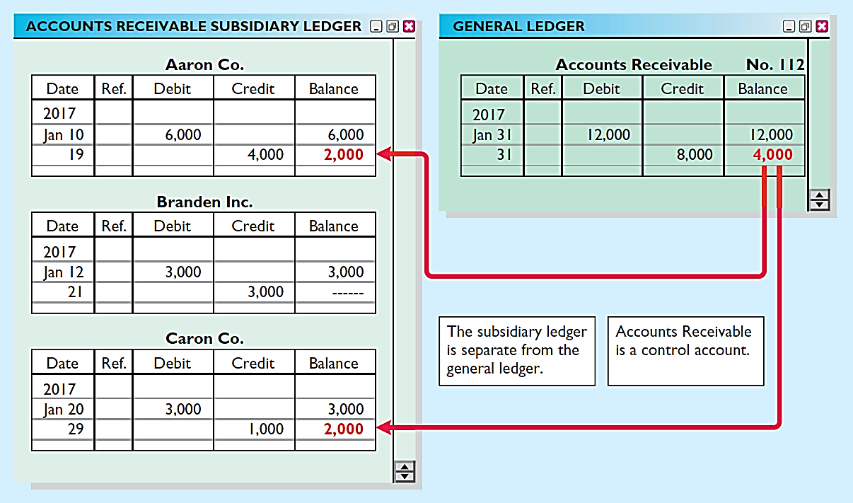
Subsidiary Ledger Example
Illustration G-3
Relationship between general and subsidiary ledgers
LO 1

Slide 7
Subsidiary Ledgers
Advantages of Subsidiary Ledgers
1. Show in a single account transactions affecting one customer or one creditor.
2. Free the general ledger of excessive details.
3. Help locate errors in individual accounts.
4. Make possible a division of labor in posting.
LO 1

Slide 8
Expanding the Journal—Special Journals
Learning Objective 2
Explain how companies use special journals in journalizing.
Used to record similar types of transactions.
Illustration G-4
Use of special journals and the general journal
If a transaction cannot be recorded in a special journal, the company records it in the general journal.
LO 2

Slide 9
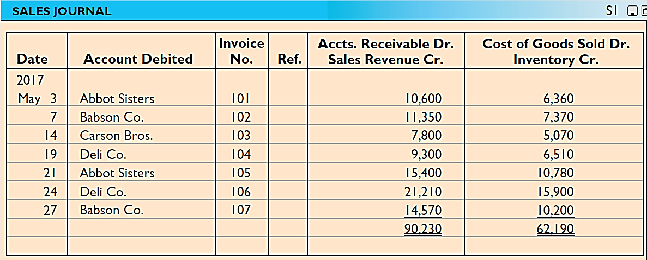
Sales Journal
JOURNALIZING CREDIT SALES
Illustration G-5
Journalizing the sales journal—perpetual inventory system
Under a perpetual inventory system, one entry at selling price in Sales Journal results in a debit to Accounts Receivable and a credit to Sales.
Another entry at cost results in a debit to Cost of Goods Sold and a credit to Inventory.
LO 2

Slide 10
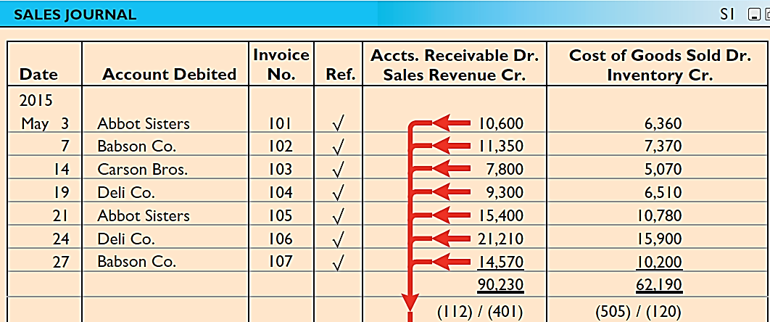
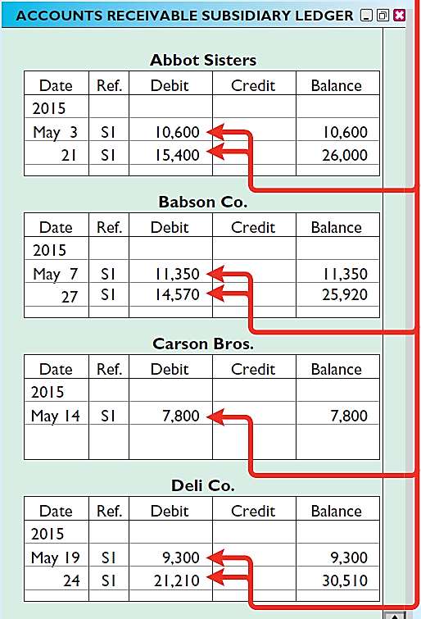
Sales Journal
Illustration G-6
Posting the sales journal
POSTING
Companies make daily postings from the sales journal to the individual accounts receivable in the subsidiary ledger.
LO 2

Slide 11
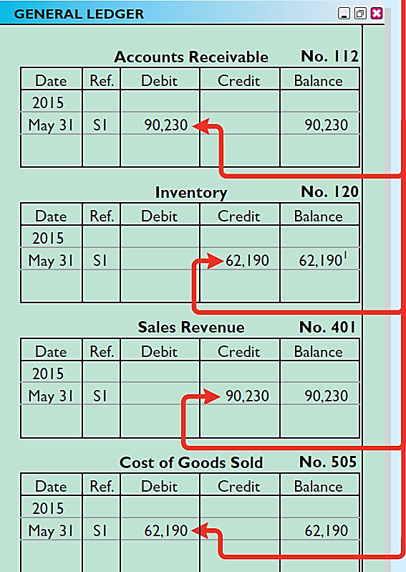
Sales Journal
Illustration G-6
Posting the sales journal
POSTING
Posting to the general ledger is done monthly.
LO 2

Slide 12
Sales Journal
ADVANTAGES OF THE SALES JOURNAL
One-line entry for each sales transaction saves time.
Only totals, rather than individual entries, are posted to the general ledger.
A division of labor results.
LO 2

Slide 13
Cash Receipts Journal
Learning Objective 3
Indicate how companies post a multi-column journal.
In the cash receipts journal, companies
record all receipts of cash.
The posting of the cash receipts journal is similar to the posting of the sales journal.
LO 3

Slide 14
Cash Receipts Journal
Illustration: May transactions of Karns Wholesale Supply. Collections from customers relate to the entries recorded in the sales journal in Illustration G-5. The entries in the cash receipts journal are based on the following cash receipts.
May 1 Stockholders invested $5,000 in the business.
7 Cash sales of merchandise total $1,900 (cost, $1,240).
10 Received a check for $10,388 from Abbot Sisters in payment of invoice No. 101 for $10,600 less a 2% discount.
12 Cash sales of merchandise total $2,600 (cost, $1,690).
17 Received a check for $11,123 from Babson Co. in payment of invoice No. 102 for $11,350 less a 2% discount.
22 Received cash by signing a note for $6,000.
23 Received a check for $7,644 from Carson Bros. in full for invoice No. 103 for $7,800 less a 2% discount.
28 Received a check for $9,114 from Deli Co. in full for invoice No. 104 for $9,300 less a 2% discount.
LO 3

Slide 15
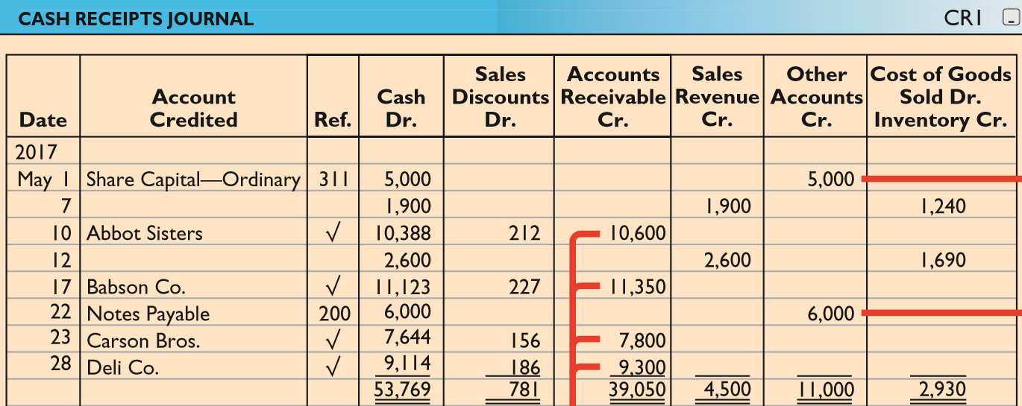
Cash Receipts Journal
Illustration G-8
Journalizing and posting the
cash receipts journal
2014
LO 3

Slide 16
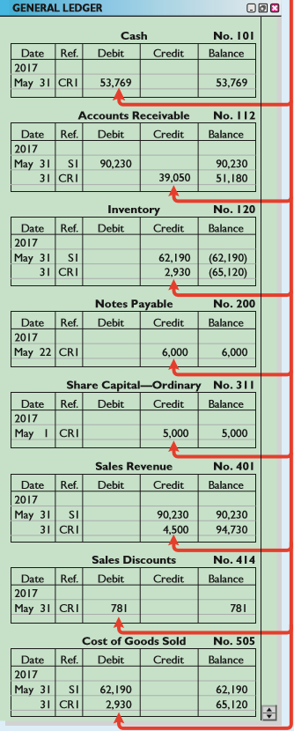
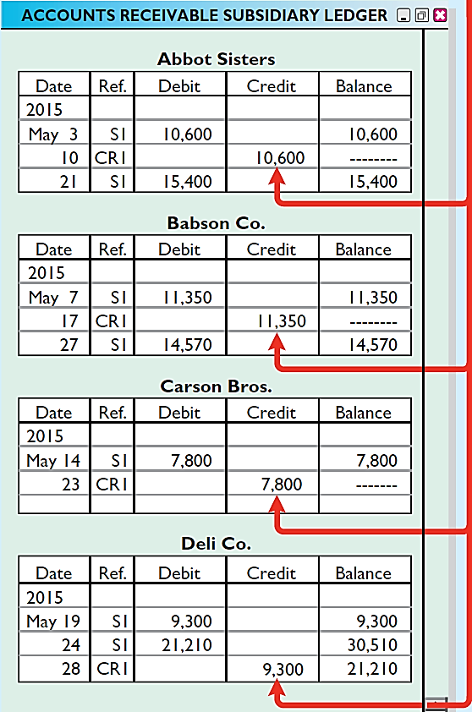
Cash Receipts Journal
2014
POSTING
Illustration G-8
Journalizing and posting the
cash receipts journal
LO 3

Slide 17
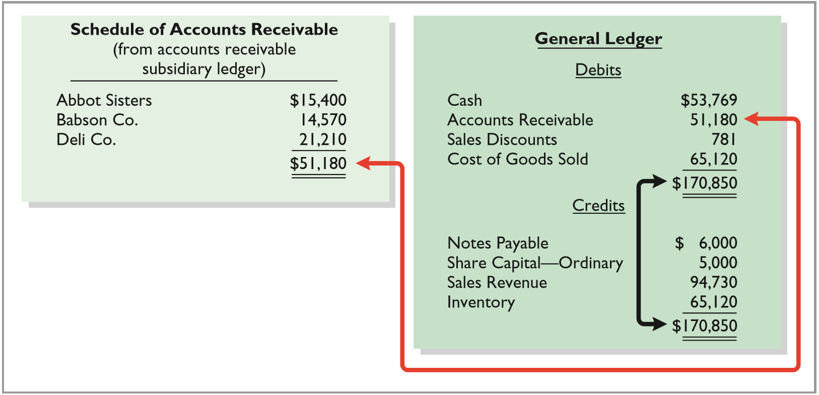
Cash Receipts Journal
Illustration G-10
Proving the ledgers after posting the sales and the cash receipts journals
LO 3

Slide 18
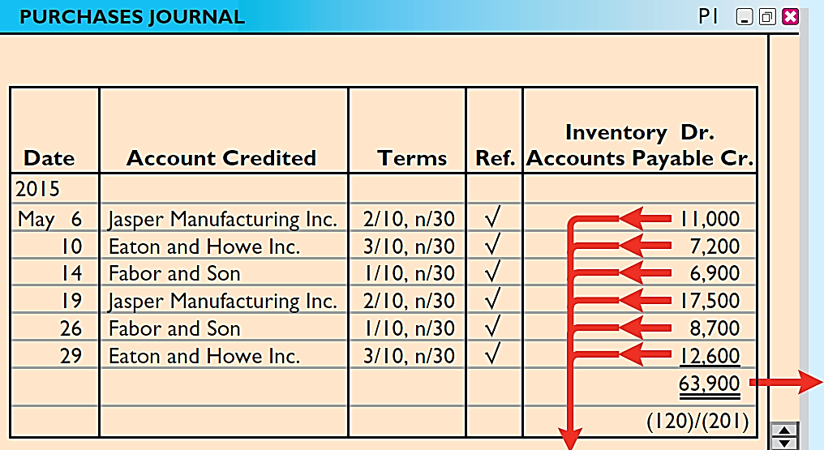
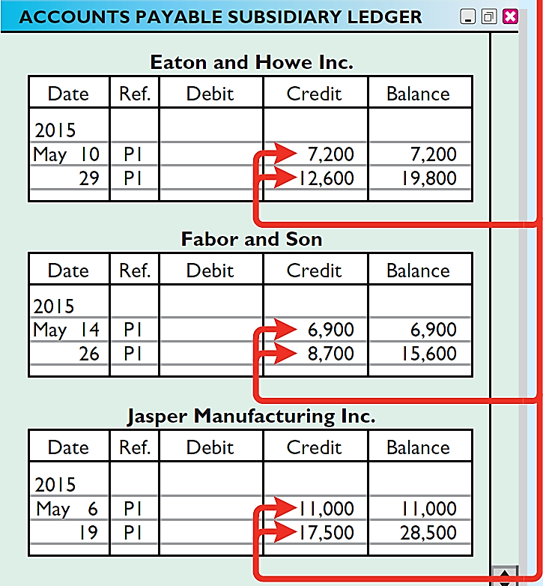
Purchases Journal
Illustration G-12
Journalizing and posting the
purchases journal
In the purchases journal, companies record all purchases of merchandise on account.
LO 3

Slide 19
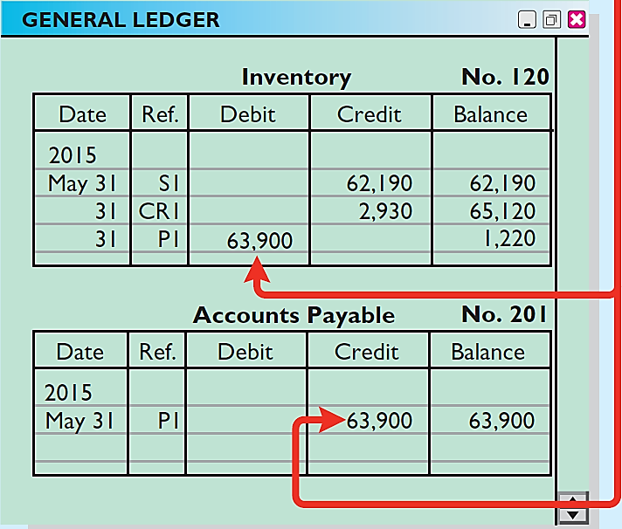
Purchases Journal
Illustration G-12
Journalizing and posting the
purchases journal
In the purchases journal, companies record all purchases of merchandise on account.
LO 3

Slide 20
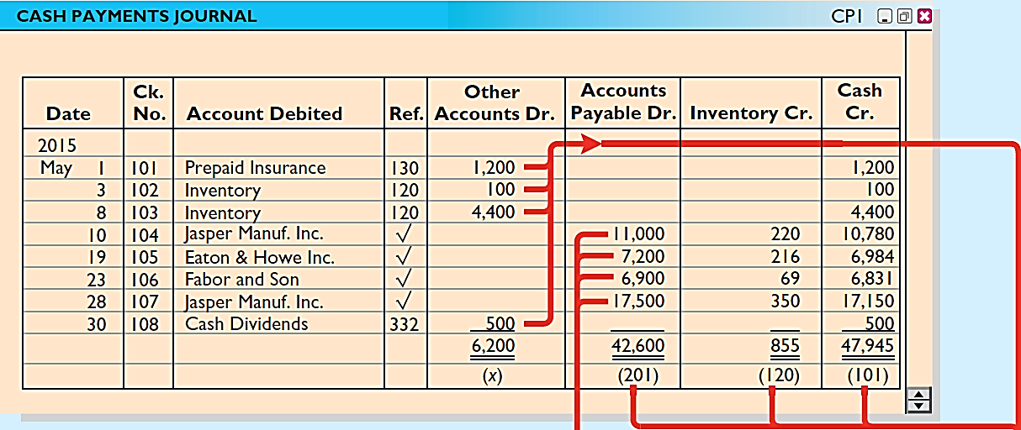
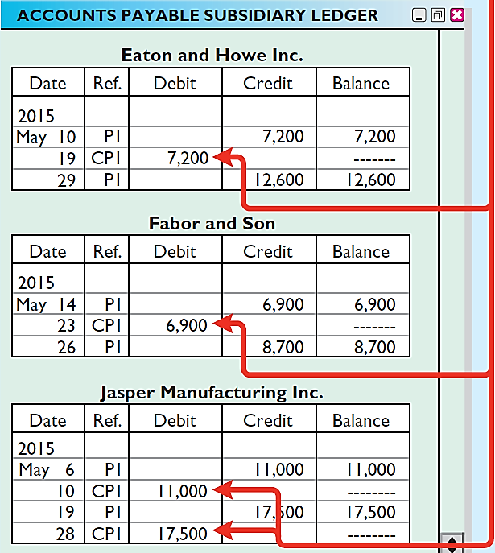
Cash Payments Journal
Illustration G-15
Journalizing and posting the cash payments journal
In a cash payments journal, companies record all disbursements of cash.
LO 3

Slide 21
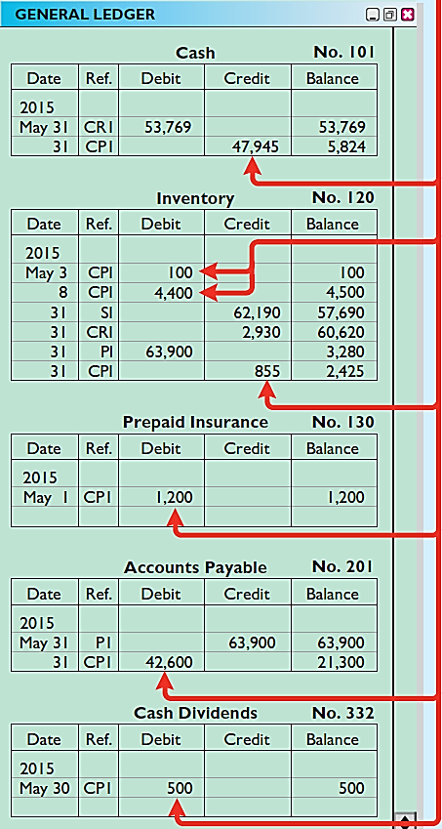
Cash Payments Journal
Illustration G-15
Journalizing and posting the cash payments journal
In a cash payments journal, companies record all disbursements of cash.
LO 3

Slide 22
Effects of Special Journals on the General Journal
Special journals substantially reduce the number of entries that companies make in the general journal.
Only transactions that cannot be entered in a special journal are recorded in the general journal.
Correcting, adjusting, and closing entries are made in the general journal.
LO 3

Slide 23
Copyright
“Copyright © 2016 John Wiley & Sons, Inc. All rights reserved. Reproduction or translation of this work beyond that permitted in Section 117 of the 1976 United States Copyright Act without the express written permission of the copyright owner is unlawful. Request for further information should be addressed to the Permissions Department, John Wiley & Sons, Inc. The purchaser may make back-up copies for his/her own use only and not for distribution or resale. The Publisher assumes no responsibility for errors, omissions, or damages, caused by the use of these programs or from the use of the information contained herein.”

