Slide 1
CSGE601020 | Dasar-Dasar Pemrograman 1
Strings
Fariz Darari
Notes:
https://pixabay.com/photos/typewriter-vintage-write-letters-1170657/

Slide 2
Strings (or text) appear anywhere
Notes:
Buku elektronik, email, media sosial, serta artikel-artikel berita dsb di web
https://pixabay.com/users/free-photos-242387/

Slide 3
What is a string?
A string is a sequence of characters
Contoh string: "Among Us" atau '!mpo5toR' atau """There is 1 Impostor among us"""
Notes:
Sequence of characters = untaian karakter
String diapit petik dua, atau petik satu (atau petik tiga jika stringnya panjang dan multi-baris)

Slide 4
String Indexing & Slicing
Each element (or character) in a string is associated with an index
A | m | o | n | g |  | U | s
0 | 1 | 2 | 3 | 4 | 5 | 6 | 7
-8 | -7 | -6 | -5 | -4 | -3 | -2 | -1
Notes:
Yang dicetak dua-duanya: U
Jangan coba-coba mengakses di luar index!

Slide 5
String Indexing & Slicing
Each element (or character) in a string is associated with an index
A | m | o | n | g |  | U | s
0 | 1 | 2 | 3 | 4 | 5 | 6 | 7
-8 | -7 | -6 | -5 | -4 | -3 | -2 | -1
s = "Among Us"
print(s[6]) # U
print(s[-2]) # U
Notes:
Yang dicetak dua-duanya: U
Jangan coba-coba mengakses di luar index!

Slide 6
String Indexing & Slicing
Each element (or character) in a string is associated with an index
A | m | o | n | g |  | U | s
0 | 1 | 2 | 3 | 4 | 5 | 6 | 7
-8 | -7 | -6 | -5 | -4 | -3 | -2 | -1
s = "Among Us"
print(s[2:5]) # ong
print(s[6:]) # Us

Slide 7
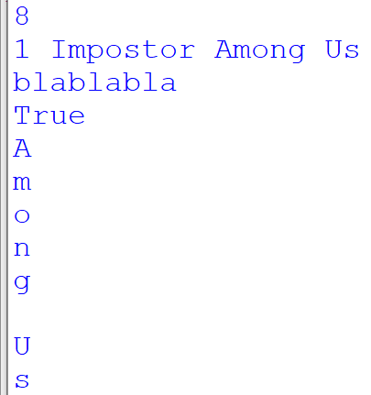
String Operations
s = "Among Us"
print(len(s))
t = "1 Impostor " + s
print(t)
u = "bla" * 3
print(u)
print("Us" in s)
for c in s:
print(c)

Slide 8
String Methods
s = "Among Us"
print(s.lower()) # among us
print(s.isdigit()) # False
print(s.find("Us")) # 6
print(s.split()) # ['Among', 'Us']
# Let's play Among Us with friends!
print("Let's play {0} with {1}!".format(s, "friends"))
print(s.replace("Us", "Them")) # Among Them
Notes:
isdigit() = Return True if all characters in the string are digits and there is at least one character, False otherwise.

Slide 9
Thanks
and don't be an impostor!
Notes:
https://www.iconfinder.com/icons/4375050/logo_python_icon
https://www.iconfinder.com/icons/3099466/determined_face_icon
https://icons8.com/icon/SmNANGG1Mkqn/among-us

