Slide 1
Dasar-Dasar Pemrograman 2: Recursion
Tim DDP 2 Fasilkom UI Correspondence: Fariz Darari (fariz@cs.ui.ac.id)
Feel free to use, reuse, and share this work: the more we share, the more we have!
Notes:
Photo by Tine Ivanič on Unsplash

Slide 2
Why?
Try this one:
Create a method to compute the factorial of a non-negative integer n, with no loops.

Slide 3
Notes:
A solution is to use recursion, that is, a method that calls itself.
https://www.flickr.com/photos/torley/2361164281

Slide 4
Solution = Recursion
Create a method to compute the factorial of a non-negative integer n, with no loops.
public static int factorialRec(int n) { if (n == 0) return 1; else return n * factorialRec(n-1); }
Notes:
Show a demo to compute factorialRec(5)!

Slide 5
Solution = Recursion
Create a method to compute the factorial of a non-negative integer n, with no loops.
public static int factorialRec(int n) { if (n == 0) return 1; else return n * factorialRec(n-1); }
Recursion = loops with no loops!
Notes:
Show stack diagram for calls, say, for 3!

Slide 6
Bonus: One-liner solution
Create a method to compute the factorial of a non-negative integer n, with no loops.
public static int factorialRec(int n) { return n == 0 ? 1 : n * factorialRec(n-1); }
Short if-else: condition ? trueCase : falseCase

Slide 7
Recursion: Base case + recursive case
public static int factorialRec(int n) { if (n == 0) return 1; else return n * factorialRec(n-1); }

Slide 8
Recursion: Base case + recursive case
public static int factorialRec(int n) { if (n == 0) return 1; else return n * factorialRec(n-1); }
Base case

Slide 9
Recursion: Base case + recursive case
public static int factorialRec(int n) { if (n == 0) return 1; else return n * factorialRec(n-1); }
Base case
Recursive case
Notes:
Make sure argument in recursive case gets simpler!

Slide 10
Recursion: Base case + recursive case
public static int factorialRec(int n) { if (n == 0) return 1; else return n * factorialRec(n-1); }
Base case
Recursive case
( ! ) Make sure argument in recursive case gets simpler!
Notes:
Make sure argument in recursive case gets simpler!

Slide 11
Quiz time: Iterative sum
Create an iterative method to compute the sum of an array of ints.

Slide 12
Quiz time: Iterative sum
Create an iterative method to compute the sum of an array of ints.
public static int sumIter(int[] ints) { int sum = 0; for(int i:ints) sum += i; return sum; }

Slide 13
Quiz time: Recursive sum
Create a recursive method to compute the sum of an array of ints.

Slide 14
Quiz time: Recursive sum
Create a recursive method to compute the sum of an array of ints.
public static int sumRec(int[] ints) { if(ints.length == 0) return 0; else return ints[0] + sumRec(Arrays.copyOfRange(ints, 1, ints.length));
}

Slide 15
Bonus: One-liner recursive sum
Create a recursive method to compute the sum of an array of ints.
One-liner version:
public static int sumRec(int[] ints) { return ints.length == 0 ? 0 : ints[0] + sumRec(Arrays.copyOfRange(ints, 1, ints.length)); }

Slide 16
More on Arrays.copyOfRange()
It's a method to copy a subarray given a range.
The method takes three arguments:
int[] : array to be copied from
from : the starting index (inclusive)
to : the finishing index (exclusive)
Example, given that int[] arr = {5,1,2}:
Arrays.copyOfRange(arr,1,arr.length) =
range

Slide 17
More on Arrays.copyOfRange()
It's a method to copy a subarray given a range.
The method takes three arguments:
int[] : array to be copied from
from : the starting index (inclusive)
to : the finishing index (exclusive)
Example, given that int[] arr = {5,1,2}:
Arrays.copyOfRange(arr,1,arr.length) = [1,2]
Arrays.copyOfRange(arr,2,2) =
range

Slide 18
More on Arrays.copyOfRange()
It's a method to copy a subarray given a range.
The method takes three arguments:
int[] : array to be copied from
from : the starting index (inclusive)
to : the finishing index (exclusive)
Example, given that int[] arr = {5,1,2}:
Arrays.copyOfRange(arr,1,arr.length) = [1,2]
Arrays.copyOfRange(arr,2,2) = []
Arrays.copyOfRange(arr,0,arr.length) =
range

Slide 19
More on Arrays.copyOfRange()
It's a method to copy a subarray given a range.
The method takes three arguments:
int[] : array to be copied from
from : the starting index (inclusive)
to : the finishing index (exclusive)
Example, given that int[] arr = {5,1,2}:
Arrays.copyOfRange(arr,1,arr.length) = [1,2]
Arrays.copyOfRange(arr,2,2) = []
Arrays.copyOfRange(arr,0,arr.length) = [5,1,2]
Arrays.copyOfRange(arr,2,5) =
range

Slide 20
More on Arrays.copyOfRange()
It's a method to copy a subarray given a range.
The method takes three arguments:
int[] : array to be copied from
from : the starting index (inclusive)
to : the finishing index (exclusive)
Example, given that int[] arr = {5,1,2}:
Arrays.copyOfRange(arr,1,arr.length) = [1,2]
Arrays.copyOfRange(arr,2,2) = []
Arrays.copyOfRange(arr,0,arr.length) = [5,1,2]
Arrays.copyOfRange(arr,2,5) = [2,0,0]
range

Slide 21
Quiz time: Recursive palindrom checking
Create a recursive method to check if a string is a palindrom.
Example:
System.out.println(isPalin("ada ada"));
System.out.println(isPalin("malam"));
System.out.println(isPalin("o"));
System.out.println(isPalin("lalala"));

Slide 22
Quiz time: Recursive palindrom checking
Create a recursive method to check if a string is a palindrom.
Example:
System.out.println(isPalin("ada ada"));
System.out.println(isPalin("malam"));
System.out.println(isPalin("o"));
System.out.println(isPalin("lalala"));
Output:
true
true
true
false

Slide 23
Quiz time: Recursive palindrom checking
Create a recursive method to check if a string is a palindrom.
public static boolean isPalin(String s) {
if(s.length() == 0 || s.length() == 1)
return true;
else
return s.charAt(0) == s.charAt(s.length()-1) &&
isPalin(s.substring(1, s.length()-1));
}

Slide 24
Don't do this anywhere!
public static void forever() { forever(); }

Slide 25
Don't do this anywhere!
public static void forever() { forever(); }
( X ) When run, it throws java.lang.StackOverflowError!
Notes:
A brief tour to stackoverflow QA website, for learning Java!

Slide 26
Talking about stackoverflow..

Slide 27
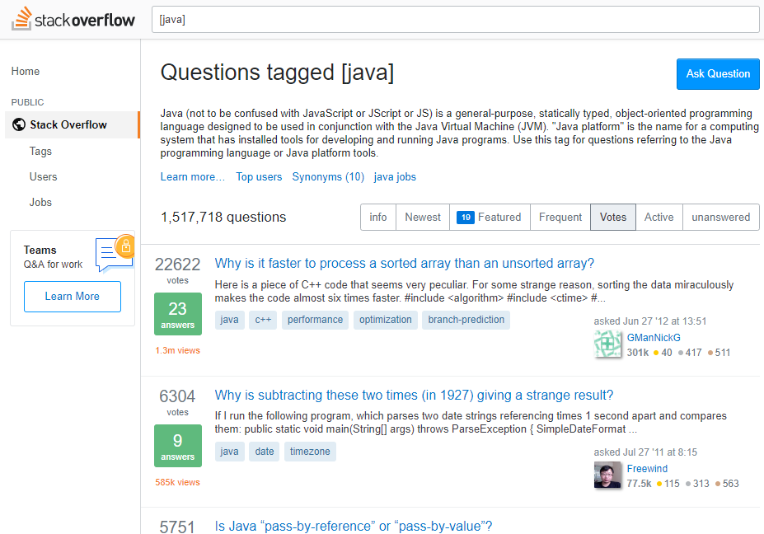
Talking about stackoverflow..

Slide 28
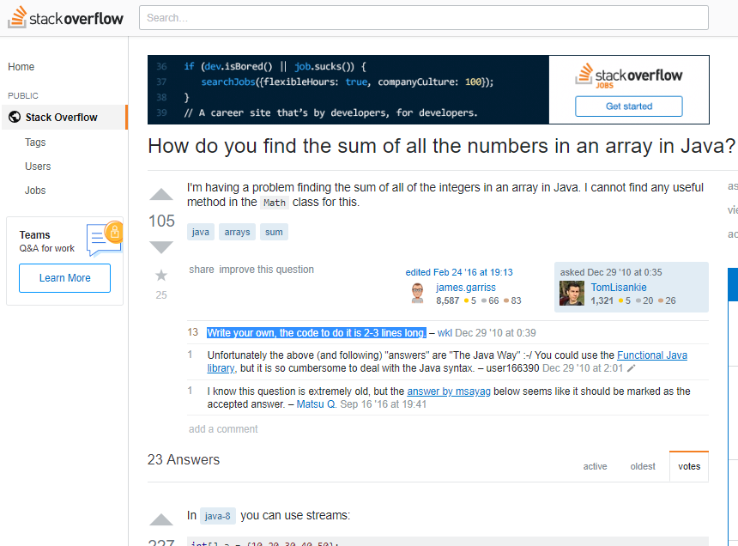
Talking about stackoverflow..
Notes:
Write your own!

Slide 29
Quiz time: Guess what the code does!
public static void cd(int n, String m) { if(n == 0) { System.out.println(m); } else { System.out.println(n); cd(n-1, m); } }
Notes:
cd(5, "HBD!");

Slide 30
Quiz time: Guess what the code does!
public static void cd(int n, String m) { if(n == 0) { System.out.println(m); } else { System.out.println(n); cd(n-1, m); } }
Answer: Count down from n to 1, then print message m
Notes:
cd(5, "HBD!");

Slide 31
Bonus: Countdown with timer!
public static void cd(int n, String m) { if(n == 0) { System.out.println(m); } else { System.out.println(n); try { Thread.sleep(1000); // sleep for 1000 ms } catch (InterruptedException e) {} cd(n-1, m); } }
Notes:
cd(10, "Semangat DDP 2 semuanyaaa!");

Slide 32
Quiz time: What's the output of cd2(5,"HBD!")!
public static void cd2(int n, String m) { if(n == 0) { System.out.println(m); } else { cd2(n-1, m); System.out.println(n); } }

Slide 33
Quiz time: What's the output of cd2(5,"HBD!")!
public static void cd2(int n, String m) { if(n == 0) { System.out.println(m); } else { cd2(n-1, m); System.out.println(n); } }
Output
HBD!
1
2
3
4
5

Slide 34
Decimal-to-binary conversion
For example, to convert 23 to its binary representation, you first repeatedly divide 23 by 2:
23 / 2 is 11 remainder 1
11 / 2 is 5 remainder 1
5 / 2 is 2 remainder 1
2 / 2 is 1 remainder 0
1 / 2 is 0 remainder 1
Then, you read these remainders from bottom to top. So, 23 in binary is 10111.

Slide 35
Quiz time: Recursive decimal-to-binary conversion Given a positive, base-10 integer, print its binary form. PS: Base case is when the integer is 0, print nothing.
public static void printDecToBin(int dec) { // complete the code.. }

Slide 36
Quiz time: Recursive decimal-to-binary conversion Given a positive, base-10 integer, print its binary form. PS: Base case is when the integer is 0, print nothing.
public static void printDecToBin(int dec) { if(dec > 0) { printDecToBin(dec / 2); System.out.print(dec % 2); } }
Notes:
Show how code works with dec = 23. Basically, it waits until reaching the bottom of the stack for printing.
If value is zero, printDecToBin does nothing (that's the base case). If the
argument is positive, the method divides it by two and calls printDecToBin
recursively. When the recursive call returns, the method displays one digit of
the result and returns (again).
The leftmost digit is at the bottom of the stack, so it gets displayed first.
The rightmost digit, at the top of the stack, gets displayed last.

Slide 37
Quiz time: Fibonacci sequence
fib(1) = 1
fib(2) = 1
fib(n) = fib(n - 1) + fib(n - 2)
Notes:
checkpoint kelas B, 28/2

Slide 38
Quiz time: Fibonacci sequence
fib(1) = 1
fib(2) = 1
fib(n) = fib(n - 1) + fib(n - 2)
public static int fib(int n) { if(n == 1 || n == 2) return 1; else return fib(n-1) + fib(n-2); }

Slide 39
Revisiting this factorial recursion
Try it out with n = 13, what happens?
public static int factorialRec(int n) { if (n == 0) return 1; else return n * factorialRec(n-1); }

Slide 40
Revisiting this factorial recursion
Try it out with n = 13, what happens?
It returns 1,932,053,504
public static int factorialRec(int n) { if (n == 0) return 1; else return n * factorialRec(n-1); }
Notes:
check using your calculator or Google if this is correct

Slide 41
Revisiting this factorial recursion
Try it out with n = 13, what happens?
It returns 1,932,053,504 (should've been 6,227,020,800). But why?
public static int factorialRec(int n) { if (n == 0) return 1; else return n * factorialRec(n-1); }

Slide 42
Revisiting this factorial recursion
Try it out with n = 13, what happens?
It returns 1,932,053,504 (should've been 6,227,020,800). But why?
Max value of int is 2,147,483,647
public static int factorialRec(int n) { if (n == 0) return 1; else return n * factorialRec(n-1); }
Notes:
Even weirder for n = 20

Slide 43
Revisiting this factorial recursion
Solution:
public static long factorialRec(int n) { if (n == 0) return 1; else return n * factorialRec(n-1); }
Notes:
return int -> long
max val of long: 9,223,372,036,854,775,807 (9 kuintiliun)

Slide 44
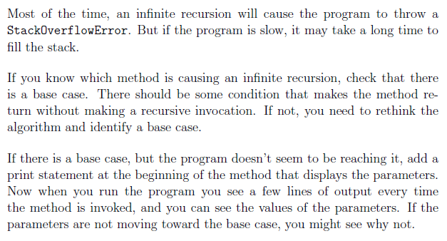
Tips: Avoiding infinite recursion
Notes:
check if there is a base cas
your recursive call must move toward the base case

Slide 45
Credits: Chapter 5 & 6 of Think Java book by Allen Downey and Chris Mayfield
Notes:
Picture: https://unsplash.com/photos/VyC0YSFRDTU

