Slide 1
Foundations of Programming 2: JavaFX Basics
FoP 2 Teaching Team, Faculty of Computer Science, Universitas Indonesia Correspondence: Fariz Darari (fariz@cs.ui.ac.id)
Feel free to use, reuse, and share this work: the more we share, the more we have!
Notes:
https://www.pexels.com/photo/time-lapse-photography-of-people-walking-on-pedestrian-lane-842339/

Slide 2
Why?
Not everything has to be in command-line interfaces (CLIs).
Non-CS people (and GUI-minded CS people) would appreciate GUIs a lot!
Notes:
https://www.iconfinder.com/icons/103422/browser_window_icon

Slide 3
Why?
Not everything has to be in command-line interfaces (CLIs).
Non-CS people (and GUI-minded CS people) would appreciate GUIs a lot!
Notes:
https://www.iconfinder.com/icons/103422/browser_window_icon

Slide 4
Why?
Not everything has to be in command-line interfaces (CLIs).
Non-CS people (and GUI-minded CS people) would appreciate GUIs a lot!
Notes:
https://www.iconfinder.com/icons/103422/browser_window_icon

Slide 5
Intro
JavaFX is a library for creating GUIs in Java.
OOPs are heavily utilized in JavaFX.
A JavaFX application can run both on a desktop and a Web browser.

Slide 6
The very basics of JavaFX
import javafx.application.Application;
import javafx.scene.Scene;
import javafx.scene.control.Button;
import javafx.stage.Stage;
public class GUI001 extends Application {
@Override
public void start(Stage stg) throws Exception {
Button button = new Button("Readyyy!");
Scene scene = new Scene(button, 250, 100);
stg.setTitle("GUI 001");
stg.setScene(scene);
stg.show();
}
public static void main(String[] args) {
Application.launch(args);
}
}

Slide 7
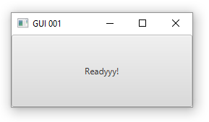
The very basics of JavaFX
import javafx.application.Application;
import javafx.scene.Scene;
import javafx.scene.control.Button;
import javafx.stage.Stage;
public class GUI001 extends Application {
@Override
public void start(Stage stg) throws Exception {
Button button = new Button("Readyyy!");
Scene scene = new Scene(button, 250, 100);
stg.setTitle("GUI 001");
stg.setScene(scene);
stg.show();
}
public static void main(String[] args) {
Application.launch(args);
}
}

Slide 8
The very basics of JavaFX
import javafx.application.Application;
import javafx.scene.Scene;
import javafx.scene.control.Button;
import javafx.stage.Stage;
public class GUI001 extends Application {
@Override
public void start(Stage stg) throws Exception {
Button button = new Button("Readyyy!");
Scene scene = new Scene(button, 250, 100);
stg.setTitle("GUI 001");
stg.setScene(scene);
stg.show();
}
public static void main(String[] args) {
Application.launch(args);
}
}
Add stg.setResizable(false); and what would happen?
Notes:
The stage won't be resizable!

Slide 9
Multiple stages
// ... other code parts follow previous code
public void start(Stage stg1) throws Exception {
stg1.setTitle("GUI 002");
stg1.setScene(new Scene(new Button("Gooo!"), 200,100));
stg1.show();
Stage stg2 = new Stage();
stg2.setTitle("GUI 002");
stg2.setScene(new Scene(new Button("Steadyyy!"), 200,100));
stg2.show();
Stage stg3 = new Stage();
stg3.setTitle("GUI 002");
stg3.setScene(new Scene(new Button("Readyyy!"), 200,100));
stg3.show();
}
Notes:
GUI002.java

Slide 10
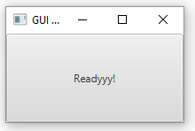
Multiple stages
// ... other code parts follow previous code
public void start(Stage stg1) throws Exception {
stg1.setTitle("GUI 002");
stg1.setScene(new Scene(new Button("Gooo!"), 200,100));
stg1.show();
Stage stg2 = new Stage();
stg2.setTitle("GUI 002");
stg2.setScene(new Scene(new Button("Steadyyy!"), 200,100));
stg2.show();
Stage stg3 = new Stage();
stg3.setTitle("GUI 002");
stg3.setScene(new Scene(new Button("Readyyy!"), 200,100));
stg3.show();
}
Close the window, you'll see the Steadyyy! stage,
close the window again, you'll see the Gooo! stage.

Slide 11
A pane is like a container
public void start(Stage stg1) throws Exception {
StackPane pn = new StackPane();
pn.getChildren().add(new Button("Niceee!")); // because Nice! would sound rude
Scene scn = new Scene(pn, 300, 100);
stg1.setScene(scn);
stg1.show();
}
Notes:
GUI003.java

Slide 12
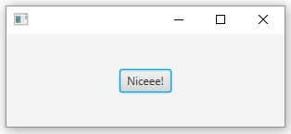
A pane is like a container
public void start(Stage stg1) throws Exception {
StackPane pn = new StackPane();
pn.getChildren().add(new Button("Niceee!")); // because Nice! would sound rude
Scene scn = new Scene(pn, 300, 100);
stg1.setScene(scn);
stg1.show();
}
Note that the button now doesn't occupy the whole scene, thanks to Pane!

Slide 13
Stacked square and button
public void start(Stage stg1) throws Exception {
Rectangle rect = new Rectangle(100, 100, 180, 140);
rect.setFill(Color.BLUE);
StackPane pn = new StackPane(rect, new Button("Niceee!"));
Scene scn = new Scene(pn, 500, 200);
stg1.setScene(scn);
stg1.show();
}
Notes:
GUI003c.java

Slide 14
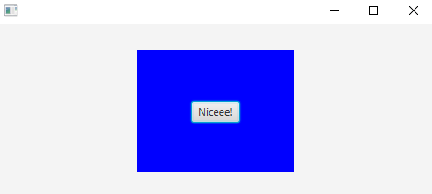
Stacked square and button
public void start(Stage stg1) throws Exception {
Rectangle rect = new Rectangle(100, 100, 180, 140);
rect.setFill(Color.BLUE);
StackPane pn = new StackPane(rect, new Button("Niceee!"));
Scene scn = new Scene(pn, 500, 200);
stg1.setScene(scn);
stg1.show();
}

Slide 15
Quiztime: Java art
Notes:
GUI003b
Checkpoint of Class B

Slide 16
Quiztime: Java art
public void start(Stage stg1) throws Exception {
StackPane pn = new StackPane();
for(int i = 100; i > 0; i--) {
Rectangle rect = new Rectangle(0,0,5*i,5*i);
switch(i % 3) {
case 0:
rect.setFill(Color.RED); break;
case 1:
rect.setFill(Color.GREEN); break;
case 2:
rect.setFill(Color.BLUE); break;
}
pn.getChildren().add(rect);
}
Scene scn = new Scene(pn, 500, 500);
stg1.setScene(scn);
stg1.show();
}
Notes:
GUI003b
Checkpoint of Class C

Slide 17
Circle
public void start(Stage stg1) throws Exception {
Circle c = new Circle();
c.setCenterX(200);
c.setCenterY(100);
c.setRadius(50);
c.setStroke(Color.ALICEBLUE);
c.setStrokeWidth(5);
c.setFill(Color.BISQUE);
Pane pn = new Pane();
pn.getChildren().add(c);
Scene scn = new Scene(pn, 400, 200);
stg1.setTitle("Life's like a circle");
stg1.setScene(scn);
stg1.show();
}
Notes:
GUI004

Slide 18
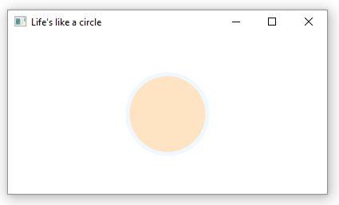
Circle
public void start(Stage stg1) throws Exception {
Circle c = new Circle();
c.setCenterX(200);
c.setCenterY(100);
c.setRadius(50);
c.setStroke(Color.ALICEBLUE);
c.setStrokeWidth(5);
c.setFill(Color.BISQUE);
Pane pn = new Pane();
pn.getChildren().add(c);
Scene scn = new Scene(pn, 400, 200);
stg1.setTitle("Life's like a circle");
stg1.setScene(scn);
stg1.show();
}

Slide 19
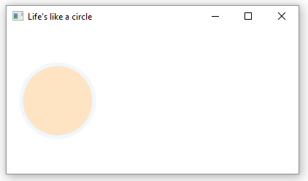
Circle
public void start(Stage stg1) throws Exception {
Circle c = new Circle();
c.setCenterX(70);
c.setCenterY(100);
c.setRadius(50);
c.setStroke(Color.ALICEBLUE);
c.setStrokeWidth(5);
c.setFill(Color.BISQUE);
Pane pn = new Pane();
pn.getChildren().add(c);
Scene scn = new Scene(pn, 400, 200);
stg1.setTitle("Life's like a circle");
stg1.setScene(scn);
stg1.show();
}

Slide 20
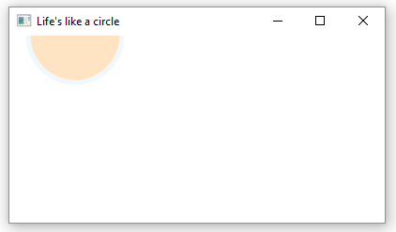
Circle
public void start(Stage stg1) throws Exception {
Circle c = new Circle();
c.setCenterX(70);
c.setCenterY(0);
c.setRadius(50);
c.setStroke(Color.ALICEBLUE);
c.setStrokeWidth(5);
c.setFill(Color.BISQUE);
Pane pn = new Pane();
pn.getChildren().add(c);
Scene scn = new Scene(pn, 400, 200);
stg1.setTitle("Life's like a circle");
stg1.setScene(scn);
stg1.show();
}

Slide 21
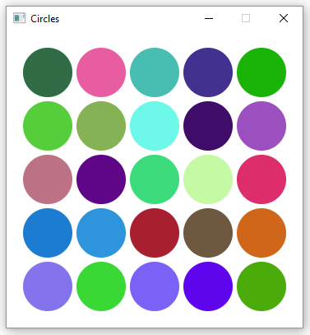
Quiztime: Loops of circles
Notes:
GUI005

Slide 22
Solution
public Circle createCircle(int X, int Y) {
Random r = new Random();
Circle c = new Circle();
c.setCenterX(X);
c.setCenterY(Y);
c.setRadius(30);
c.setFill(Color.rgb(r.nextInt(256), r.nextInt(256), r.nextInt(256)));
return c;
}
// ... cont

Slide 23
Solution
// ... cont
@Override
public void start(Stage stg1) throws Exception {
Pane pn = new Pane();
for(int i = 0; i < 5; i++)
for(int j = 0; j < 5; j++)
pn.getChildren().add(createCircle(50 + i*65,50 + j*65));
Scene scn = new Scene(pn, 360, 360);
stg1.setTitle("Circles");
stg1.setScene(scn);
stg1.setResizable(false);
stg1.show();
}

Slide 24
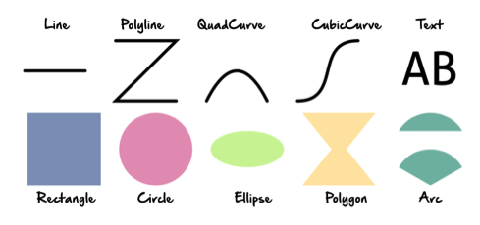
JavaFX provides many other shapes
Image copyright: https://dzone.com/refcardz/javafx-8-1?chapter=6

Slide 25
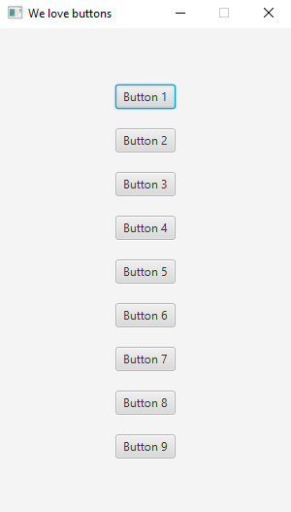
Quiztime: We love buttons
Notes:
GUI006

Slide 26
Solution
@Override
public void start(Stage stg1) throws Exception {
VBox pn = new VBox();
pn.setAlignment(Pos.CENTER);
pn.setSpacing(20);
for(int i = 1; i <= 9; i++)
pn.getChildren().add(new Button("Button " + i));
Scene scn = new Scene(pn, 300, 500);
stg1.setTitle("We love buttons");
stg1.setScene(scn);
stg1.setResizable(false);
stg1.show();
}

Slide 27
Quiztime: We love horizontal buttons
Notes:
GUI007

Slide 28
Solution
@Override
public void start(Stage stg1) throws Exception {
HBox pn = new HBox();
pn.setAlignment(Pos.CENTER);
pn.setSpacing(20);
for(int i = 1; i <= 9; i++)
pn.getChildren().add(new Button("Button " + i));
Scene scn = new Scene(pn, 800, 200);
stg1.setTitle("We love buttons");
stg1.setScene(scn);
stg1.setResizable(false);
stg1.show();
}

Slide 29
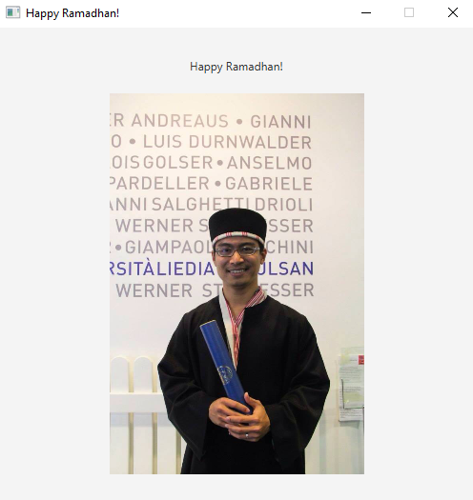
JavaFX Labels and Images
Notes:
GUI008

Slide 30
Solution
public void start(Stage stg1) throws Exception {
VBox pn = new VBox();
pn.setAlignment(Pos.CENTER);
pn.setSpacing(20);
pn.getChildren().add(new Label("Happy Ramadhan!"));
FileInputStream fis = new FileInputStream("pics/ramadhan.jpg");
Image img = new Image(fis);
ImageView iv = new ImageView(img);
iv.setFitHeight(400);
iv.setPreserveRatio(true);
pn.getChildren().add(iv);
Scene scn = new Scene(pn, 500, 500);
stg1.setTitle("Happy Ramadhan!");
stg1.setScene(scn);
stg1.setResizable(false);
stg1.show();
}

Slide 31
Quiztime: Create your own Happy Ramadhan (or Merry X-Mas, or any greetings!

Slide 32
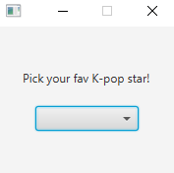
ChoiceBox
Notes:
GUI009

Slide 33
ChoiceBox: Code
public void start(Stage stg1) throws Exception {
VBox pn = new VBox();
pn.setAlignment(Pos.CENTER);
pn.setSpacing(20);
pn.getChildren().add(new Label("Pick your fav K-pop star!"));
String[] stars = {"Joo Ko-Wee", "Park Bo-Wow"};
ChoiceBox cb = new ChoiceBox(FXCollections.observableArrayList(stars));
pn.getChildren().add(cb);
Scene scn = new Scene(pn, 180, 150);
stg1.setScene(scn);
stg1.setResizable(false);
stg1.show();
}

Slide 34
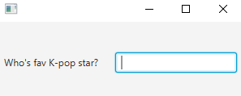
TextField
Notes:
GUI010
Sandiaga Yunho

Slide 35
TextField: Code
public void start(Stage stg1) throws Exception {
HBox pn = new HBox();
pn.setAlignment(Pos.CENTER);
pn.setSpacing(20);
pn.getChildren().add(new Label("Who's fav K-pop star?"));
TextField tf = new TextField();
tf.setPrefWidth(150);
pn.getChildren().add(tf);
Scene scn = new Scene(pn, 300, 100);
stg1.setScene(scn);
stg1.show();
}
Notes:
Sandiaga Yunho

Slide 36
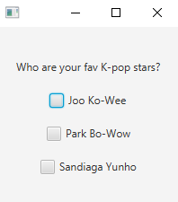
CheckBox
Notes:
GUI011

Slide 37
CheckBox: Code
public void start(Stage stg1) throws Exception {
VBox pn = new VBox();
pn.setAlignment(Pos.CENTER);
pn.setSpacing(20);
pn.getChildren().add(new Label("Who are your fav K-pop stars?"));
CheckBox cb1 = new CheckBox("Joo Ko-Wee");
CheckBox cb2 = new CheckBox("Park Bo-Wow");
CheckBox cb3 = new CheckBox("Sandiaga Yunho");
pn.getChildren().add(cb1);
pn.getChildren().add(cb2);
pn.getChildren().add(cb3);
Scene scn = new Scene(pn, 200, 200);
stg1.setScene(scn);
stg1.show();
}

Slide 38
Inspired by:
Liang, Introduction to Java, 10th edition, Pearson.
https://www.geeksforgeeks.org/
Google
Notes:
Picture: https://unsplash.com/photos/VyC0YSFRDTU

