Slide 1
HISTORY OF POSITIVE DEVIANCE
Session 2

Slide 2
TABLE OF CONTENTS
01
02
03
04
First used the term of PD
The domain of knowledge using the term of PD
The use of PD in various problems
Countries that use PD as a problem solver

Slide 3
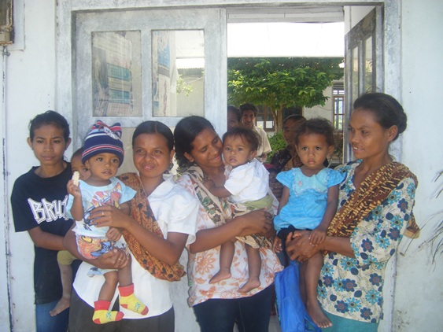
01
First used the term of PD

Slide 4
1976
After 1990
1990
Wishik and Van Der Vynckt
PD approach has been used to find solutions to child malnutrition in many countries
Marian Zeitlin

Slide 5
02:
The domain of knowledge using the term of PD

Slide 6
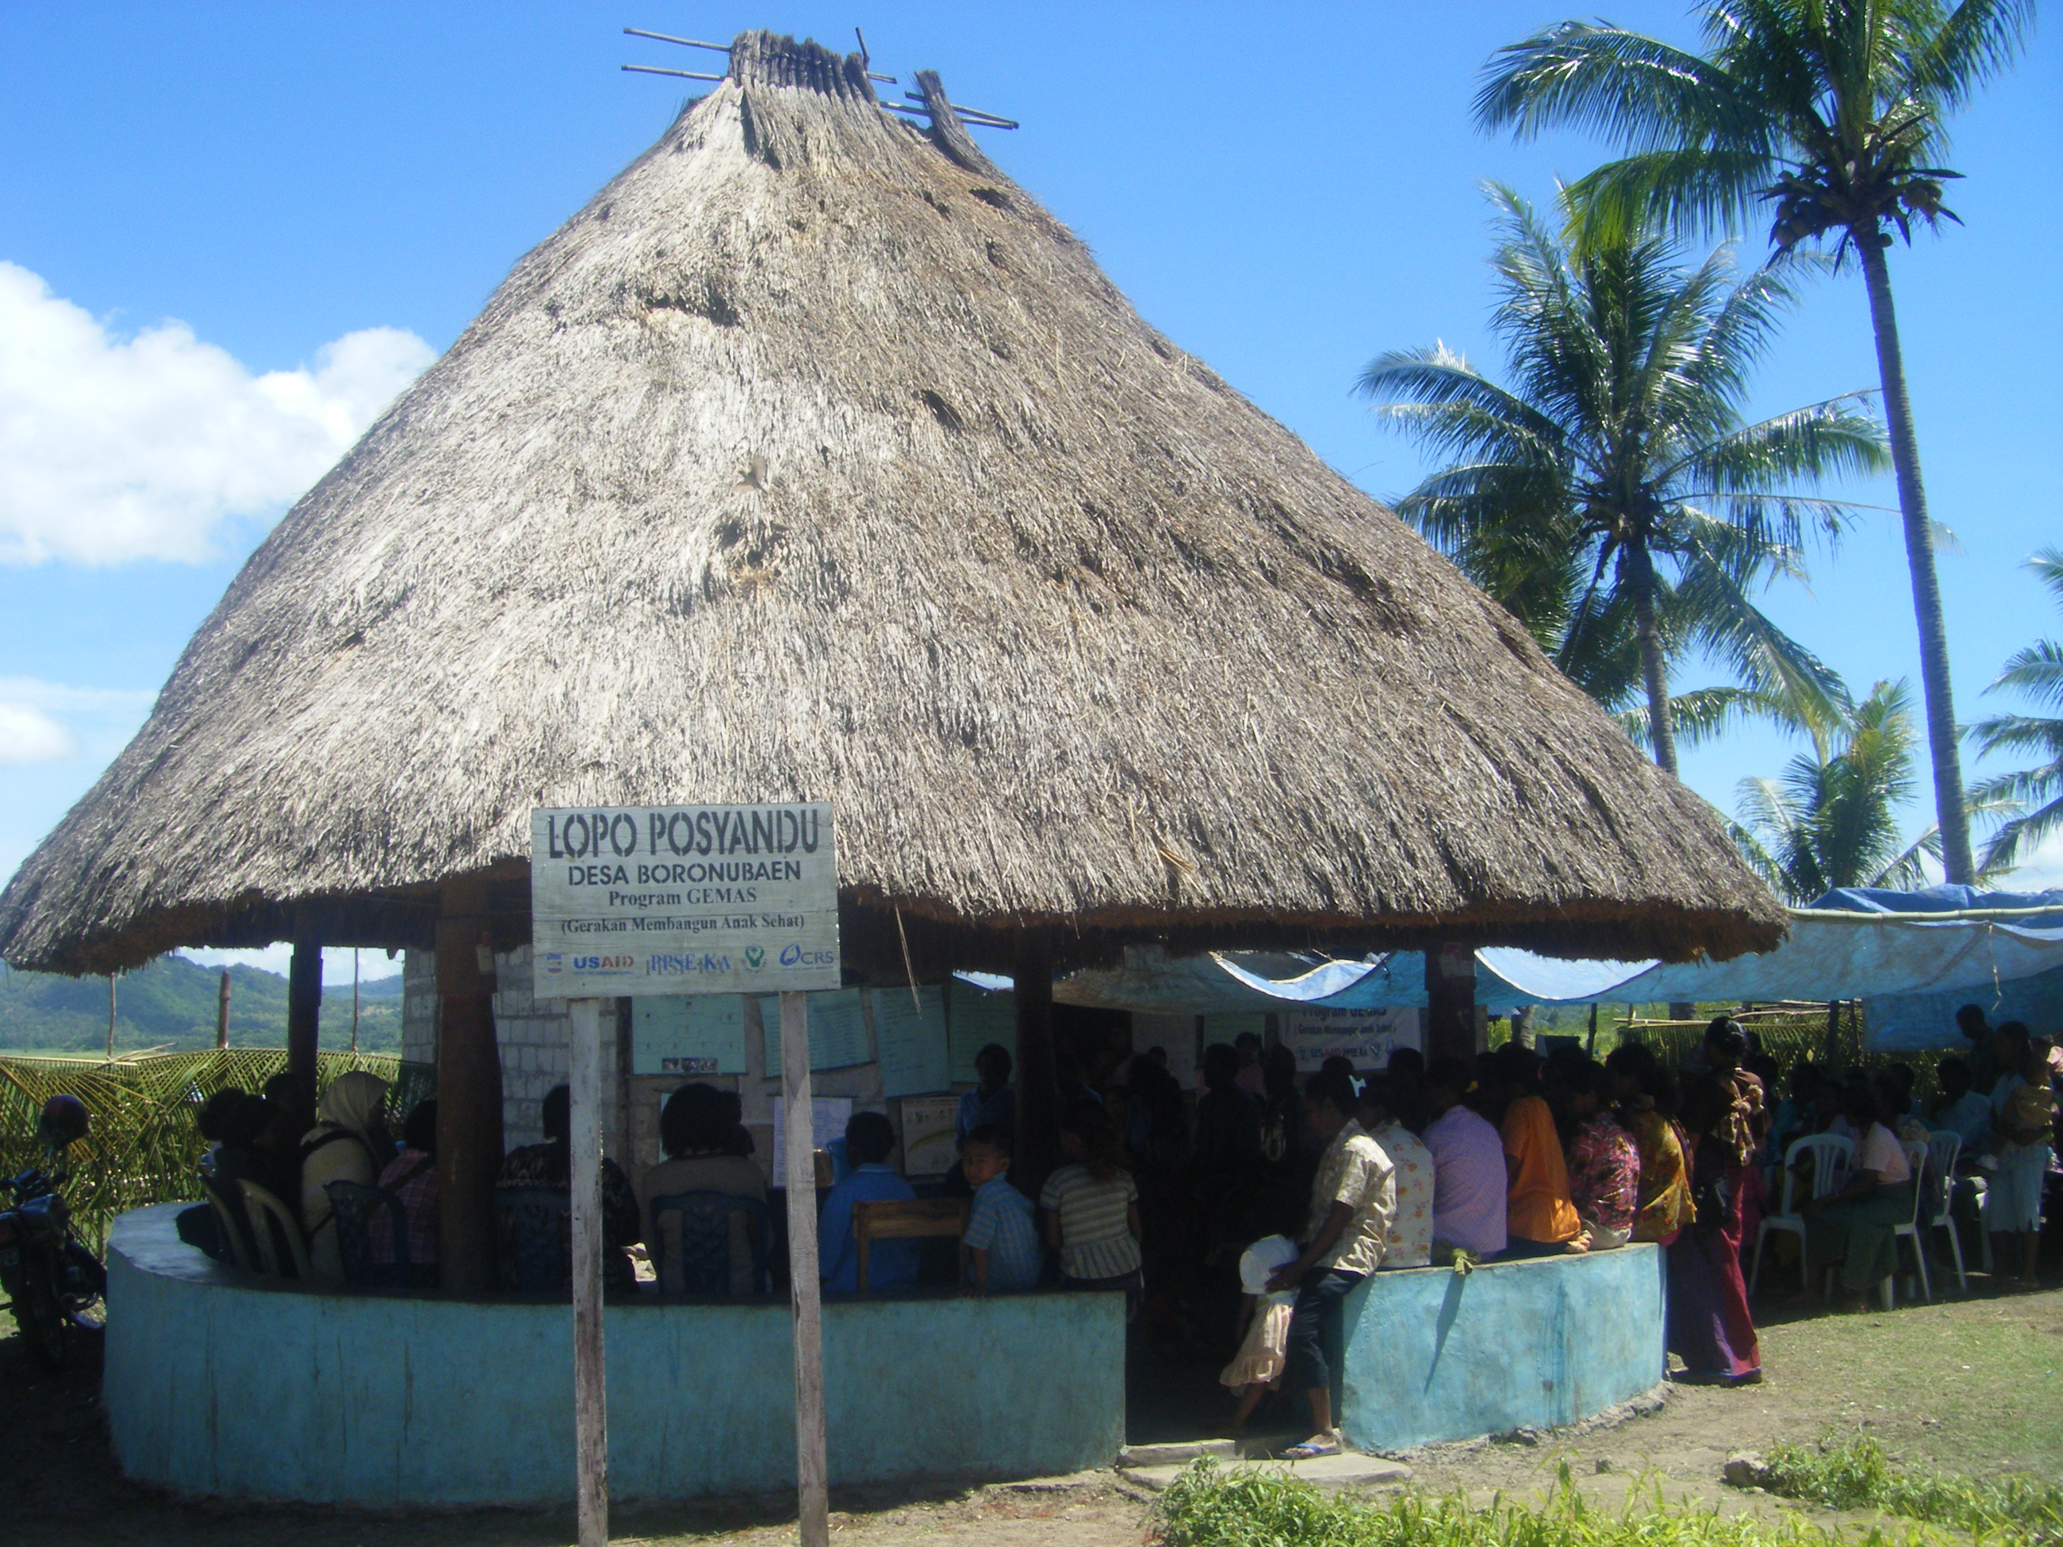
Pitirim Sorokin in 1950s
a sociologist, was the first to raise the idea that deviance can be negative or positive

Slide 7
03:
The use of PD in various problems

Slide 8
Kim, Heerey, & Kols (2008)
Awofeso, Irwin, & Forrest (2008)
Singhal & Greiner (2007)
Sternin (2002)
Gertner (2008)
PDI (2010)
nurse-patient communication in Indonesia
smoking cessation in Australian prisons
Methicillin-resistant Staphylococcus aureus (MRSA) prevention in U.S. hospitals
mothers feeding children shrimp in Vietnam to prevent malnutrition
an orderly sealing an MRSA exposed gown inside a glove to prevent transmission in a hospital
HIV-negative sex worker telling clients she “has the disease” if they refuse to use a condom, which scares them so much they agree to wear it

Slide 9
04:
Countries that use PD as a problem solver

Slide 10
Bangladesh
Haiti
Vietnam
India
Rwanda
Indonesia

Slide 11
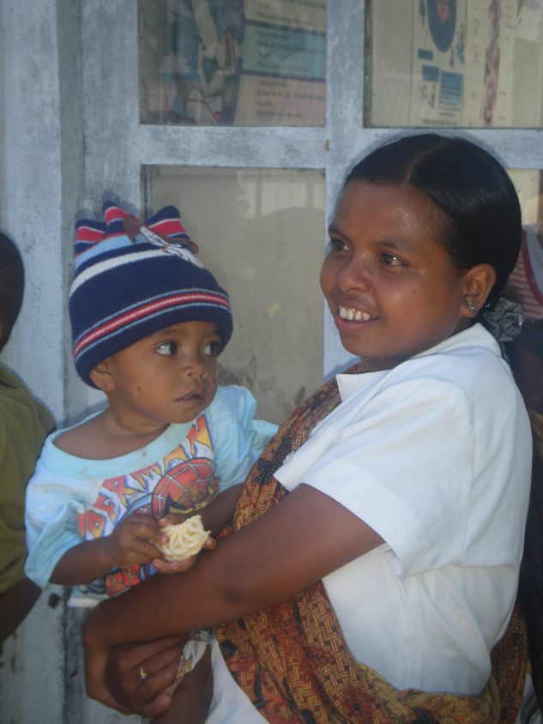
NEXT…
Watch this video and discuss it
https://www.youtube.com/watch?v=B8J4fc3XyV4&ab_channel=TEDxTalks

