Slide 1
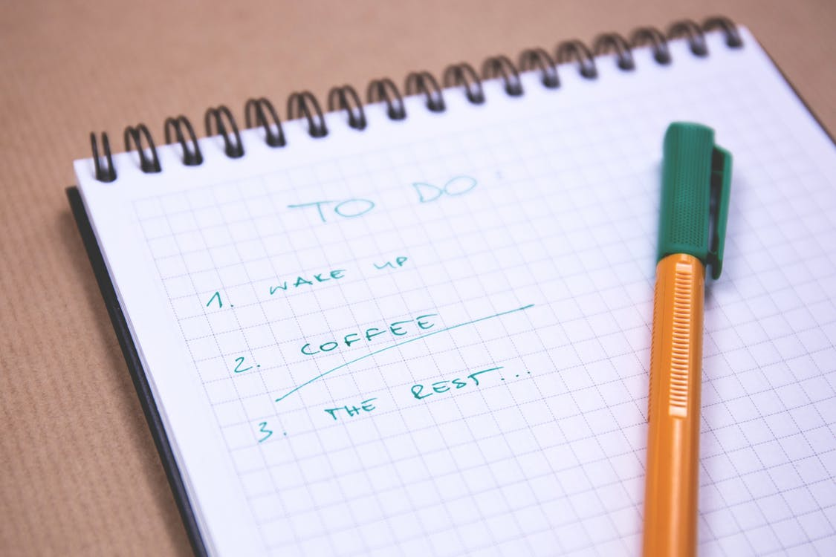
CSGE601020 | Foundations of Programming 1
Python Lists
Fariz Darari
A video lecture using this slideset is available (+ other cool Python tutorial videos):
https://bit.ly/pymooc-id
Notes:
https://www.pexels.com/photo/orange-and-green-pen-on-graphing-notepad-131979/

Slide 2
Oftentimes, we do not deal just with one data unit
Notes:
Daftar teman, daftar kode Python yang sudah kita buat sejauh mengikuti kuliah pemrograman Python (pasti sudah banyak kan?), lalu daftar makanan favorit
https://www.pexels.com/photo/background-book-stack-books-close-up-1148399/

Slide 3
For that reason, we need lists to store collections of objects
book_list = ["The Rainbow Troops", "Goosebumps", "Harry Potter"]
todo_list = ["wake up", "coffee", "the rest"]
Notes:
Lists can be used to store a collection of objects, mention how lists syntactically look like

Slide 4
For that reason, we need lists to store collections of objects
book_list = ["The Rainbow Troops", "Goosebumps", "Harry Potter"]
todo_list = ["wake up", "coffee", "the rest"]
favorite_year_list = [2018, 2019, 2021]
answer_list = [True, False, False]
Notes:
Not only strings, but really any object

Slide 5
For that reason, we need lists to store collections of objects
book_list = ["The Rainbow Troops", "Goosebumps", "Harry Potter"]
todo_list = ["wake up", "coffee", "the rest"]
favorite_year_list = [2018, 2019, 2021]
answer_list = [True, False, False]
mix_list = ["str", 7, 3.14, True]
list_of_lists = [[1, 0, 1],[0, 0, 1]]
Notes:
Can mix types
and can also contain lists (lists inside lists)

Slide 6
List operations
todo_list = ["wake up", "coffee", "the rest"]
print(todo_list[1]) # coffee
print(todo_list[-1]) # the rest
print(todo_list[:2]) # ['wake up', 'coffee']
print("tea" in todo_list) # False
print("coffee" in todo_list) # True
print(len(todo_list)) # 3
Notes:
Kind of similar to strings

Slide 7
List operations
programmer_todo_list = ["eat", "pray", "code"]
programmer_todo_list = programmer_todo_list + ["love"]
print(programmer_todo_list)
programmer_todo_list[2] = "programming"
print(programmer_todo_list)
del programmer_todo_list[0] # in reality, we should eat!
print(programmer_todo_list)
Notes:
Programmers also need love sometimes

Slide 8
List iteration
chef_todo_list = ["eat", "pray", "cook"]
for todo in chef_todo_list:
print(todo)
print("~~~")
for i in range(len(chef_todo_list)):
print(chef_todo_list[i])
Notes:
Programmers also need love

Slide 9
List methods
todos = ["eat", "pray", "code"]
print(todos.index("pray")) # 1
print(todos.pop()) # code
print(todos) # ['eat', 'pray']
todos.append("sleep")
print(todos) # ['eat', 'pray', 'sleep']

Slide 10
List methods
todos = ["eat", "pray", "code"]
print(todos.index("pray")) # 1
print(todos.pop()) # code
print(todos) # ['eat', 'pray']
todos.append("sleep")
print(todos) # ['eat', 'pray', 'sleep']
todos.reverse()
print(todos) # ['sleep', 'pray', 'eat']
todos.remove("sleep")
print(todos) # ['pray', 'eat']
todos.extend(["swim", "shop"])
print(todos) # ['pray', 'eat', 'swim', 'shop']
todos.sort()
print(todos) # ['eat', 'pray', 'shop', 'swim']

Slide 11
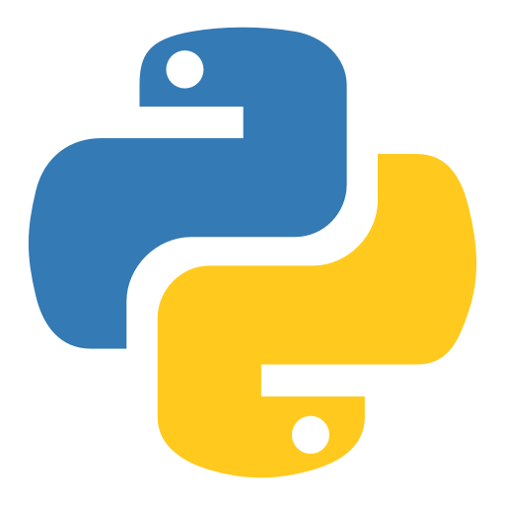
["thank", "you", "and", "see", "you", "in", "another", "video"]
Notes:
https://www.iconfinder.com/icons/4375050/logo_python_icon

