Slide 1
Teori Sosiologi Modern tentang Stratifikasi Sosial KULIAH 3
Mata Kuliah Stratifikasi Sosial
Program Studi Sarjana Sosiologi FISIP UI
Materi kuliah, harap tidak dikutip

Slide 2
Sebelum membahas teori2 Dahrendorf, Wright, Goldthorpe, dan Grusky, perlu diperhatikan:
Apa perbedaan antara Marx-Marxian dan Weber-Weberian dalam menganalisis stratifikasi?
Apa perbedaan antara Teori Umum (General) dengan teori Menengah (Middle-Range)?
Bagaimana hubungan antara teori Dahrendorf dipengaruhi oleh teori Marx?
Bagaimana hubungan antara teori Wright dengan teori Weber?

Slide 3
PETA TEORI
TEORI KLASIK | TEORI MODERN
Marx: Metode Produksi, Kepemilikan Alat Produksi | Wright: proses eksploitasi, kelas produksi
Weber: kesempatan hidup (“Life- chances’) | Goldthorpe: situasi pasar
Durkheim: Asosiasi Okupasi (pekerjaan) (“golongan fungsional pekerjaan”) | Grusky: golongan okupasi
 | Dahrendorf: Otoritas (Weber) dan Konflik (Marx)

Slide 4
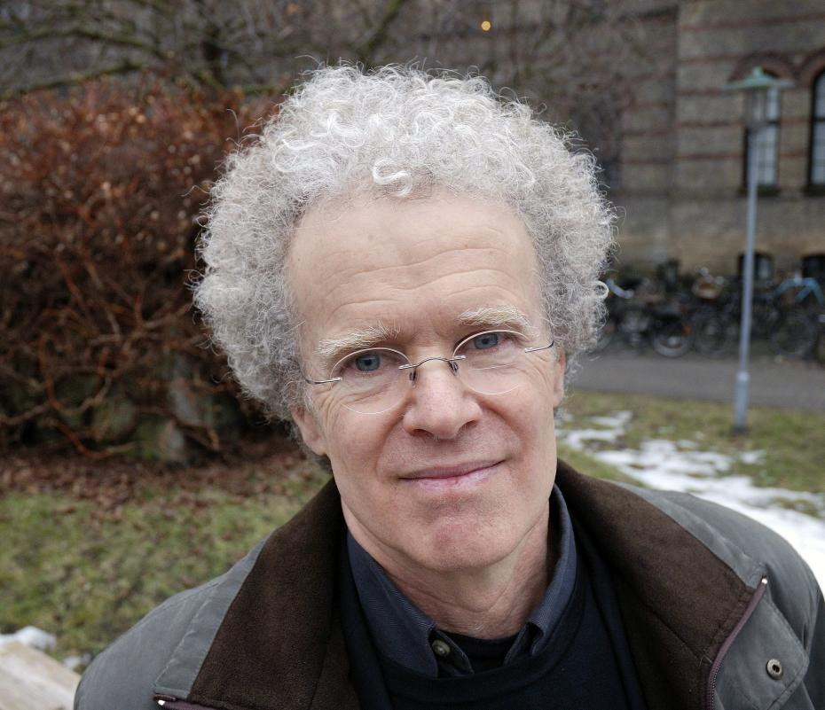
Teoretisi Sosiologi (Kelas dan Stratifikasi)
Ralf Dahrendorf
Erik Olin Wright

Slide 5
Teoretisi Sosiologi (Kelas dan Stratifikasi)
David Grusky
John Goldthorpe

Slide 6
Ralf Dahrendorf (1)
Adanya fenomena joint-stock company di Eropa Barat dan Amerika pada paruh kedua abad 19.
By separating ownership and control, the joint-stock company give rise to a new group of manager who are utterly different from their capitalist predecessors.
For Marx, by separating ownership and control, the joint-stock company reduce the distance between manager and worker; at the same time removing the owners altogether from the sphere of production; thereby isolating their function as exploiters of others.

Slide 7
Ralf Dahrendorf (2)
Renner: ‘the capitalists without function’ yield to the ‘functionaries without capital’.
The process of transition from capitalist enterprises to joint-stock companies can be described as a process of role differentiation.
The roles of owner and manager, originally combined in the position of the capitalist, have been separated and distributed over two positions, those of stockholders and executive.

Slide 8
Ralf Dahrendorf (3)
Effect of separation and control:
Manifest effect: two physical entities occupies the positions formerly occupied by one.
Latent effect:
Capitalist without function.
Marx: capitalist is alienated from production
Capitalist does not have a defined place in the formal hierarchy of authority in the enterprise.
Functionaries without capital.
Functionaries have place in the formal hierarchy of authority
Functionaries do not have property in the enterprise.

Slide 9
Ralf Dahrendorf (4)
Today’s working class, far from being a homogeneous groups of equally unskill and impoverished people.
There emerged a new category of workers which today is usually described as semiskilled workers.

Slide 10
Ralf Dahrendorf (5)
The semiskilled workers differ from the unskilled workers in terms of:
Technical qualifications required form them for their work (not much)
Capacity to accept responbility
Ability to adapt to difficult conditions
Ability to perform a job intelligently.

Slide 11
Ralf Dahrendorf (6)
There are three skill groups:
Highly skilled workmen
Semiskilled workers
Totally unskilled laborers
These three groups differ not only in their level of skill, but also in other attributes and determinants of social status.
The hierarchy of skill corresponds to the hierarchy of responsibility and delegated authority within the working class.

Slide 12
Ralf Dahrendorf: The New Middle Class
There are two theories:
Croner, Bendix and others: the ‘new middle class’ constitutes in fact an extension of the old, capitalist or bourgeouis, rulling class, and is in the sense part of the rulling class.
Geiger, Mills and others: the ‘new middle class’ is, if not exactly an extension of the proletariat, at any rate closer to the working class than to the rulling class.

Slide 13
Erik Olin Wright (1)
The most elaborated and systematic theoretical framework for class analysis is found in the Marxist tradition.
Class analysis becomes the core of a wide-ranging agenda of research on the causes and consequences of class relations.
The task of class analysis is not simply to understand class structure and its effects, but to understand the interconnections among all these elements and their consequecee for the other aspects of social life.

Slide 14
Erik Olin Wright (2)
There are three dimensions of control over economic resources in modern capitalist production:
Control over investments or money capital
Control over the physical means of production (land or factories and offiices)
Control over labor power

Slide 15
Erik Olin Wright (3)
Elements of class analysis are:
Class stucture → plays a pivotal role in class analysis
Class formation: the formation of classes into collectively organized actors
Class struggle: the practice of actors of their class interests
Class consciousness: the understanding of actors of their class interests
The interests of workers and capitalists are deeply antagonistic, one of the core ideas of Marxist class analysis.

Slide 16
Erik Olin Wright (4)
Within the Marxist tradition of class analysis, class divisions are defined primarily in terms of the linkage between property relations and exploitation.
In capitalist society, the central form of exploitation is based on property rights in the means of production.

Slide 17
Erik Olin Wright (5)
These property rights generate three basis classes:
Capitalists (exploiters), who own the means of production and hire workers
Workers (exploited), who do not own the means of production and sell their “labor power” to capitalists
Petty bourgeois (neither exploiters nor exploted), who own and use the means of production without hiring others.
Conflict between capitalists and workers is not simply over the level of wages, but over the amount of work effort performed for those wages.

Slide 18
Erik Olin Wright: “Middle Class” Among Employees (1)
Wright divides the class of employees along two dimensions:
Their relationship to authority within production
Their possession of skills or expertise.

Slide 19
Erik Olin Wright: “Middle Class” Among Employees (2)
1. Authority
Two rationales for treating authority as a dimension of class relations among employees:
a. The role of domination within capitalist property relations.
Capitalists own the means of production, hire workers, and also dominate workers within production.
Managers and supervisors can be considered simulataneously in the capitalist class and the working class.
They occupy contradictory locations within class relations.

Slide 20
Erik Olin Wright: “Middle Class” Among Employees (3)
b. The relationship between the earnings and the appropriation of surplus.
The strategic position of managers within organization of production enables them to make significant claim on a portion of the social surplus – the part of the socially produced product left over after all inputs have been paid for – in the form of relatively high earnings.
By virtue of this appropriation of surplus by managers they should generally be seen as exploiters.

Slide 21
Erik Olin Wright: “Middle Class” Among Employees (4)
Managers occupies a privileged position with respect to the process of exploitation which enables them to appropriate part of the social surplus in the form of higher income.
Managers not only occupy contradictory locations within class relations by vitue of domination, they occupy a privileged appropriation location within exploitation relations. These differentiate them from the working class.

Slide 22
Erik Olin Wright: “Middle Class” Among Employees (5)
2. Skills and Expertise
Managers or employees who posses high level of skill/expertise are potentially in a privileged appropriation location within exploitation relations

Slide 23
Erik Olin Wright: “Middle Class” Among Employees (6)
Two primary mechanism through which this can happen:
Skill and espertise are frequently scarce in labor markets because they are in short supply and systematic obstacles (credentials, rare talents, etc)
Employees with high level of expertise are able to appropriate surplus because of their strategic location within the organization of producion (as controller of knowledge), and because of their strategic location in the organization of labor markets (as controllers of a scarce form of labor power).

Slide 24
Erik Olin Wright: “Middle Class” Among Employees (7)
The possesion of skills and expertise defines a distinctive location within class relations because of a specific kind of power they confer on employees – power in labor markets to capture skill, rent and power within production to capture loyalty rents.
It may also be the case that expertise, skills and knowledge are associated with various kinds of “symbolic capital” and distinctive life-style (Bordieu)
The important theoretical idea is that skills and expertise designate an asset emboided in the labor power of people which enhances their power in labor markets and labor processes.

Slide 25
Goldthorpe (Breen: 2005: 36)
*The class schema developed by John Goldthorpe and his associates (Goldthorpe 1980; Erikson, Goldthorpe, and Portocarero 1979; Erikson and Goldthorpe 1992) has been extensively used in empirical class analysis during the past twenty years. Initially, the schema was presented as distinguishing occupations on the basis of their market and work situations.
*Market situation refers to an occupation’s sources and levels income, its associated conditions of employment, degree of economic security, and chances, for its holders, of economic advancement.
*Work situation refers to an occupation’s location within systems of authority and control in the production process (Goldthorpe 1980, p. 40). Occupations that typically share common market and work situations were held to constitute classes and occupants of different classes were held to enjoy different life chances.

Slide 26
GOLDTHORPE (2)
Differentiation gave rise to a net increase in training and education, a multiplication of scarce, yet desirable, technical and professional skills, and, thus, an emergence of a prominent middle-class.
All these elements, in combination with an increase in managerial and administrative requirements due to complexities and bureaucratization inherent in industrial societies, produce a diversification of occupations, which can be classified according to the relations they form with each other.

Slide 27
GOLDTHORPE (3)
*Goldthorpe divides social stratification schemata into models that focus on either class structure or social hierarchy.
*Class structure refers to conceptualizations relating to the social positions of actors as identified by their relations within the labour market.
*In contrast, social hierarchy refers to an approach that, according to Goldthorpe, is interested in a single hierarchical dimension, e.g. prestige, status, economic resources, etc.
* He places his class schema into the former category and objects to the latter because it suggests a “vertical,” i.e. ascending/descending, dimension and, thus, is either too limited for his purposes or misleading as far as social structure is concerned.

Slide 28
GOLDTHORPE (4)
*For instance, he argues that skilled industrial workers, small proprietors, and minor officials may occupy a similar position in a hierarchy, but may be subjected to very different technical and economic realities (e.g. innovations or governmental policies) as far as their class position is concerned.
*Members within classes, in contrast, are relatively homogeneous in kind and level of resources, have similar experiences with regard to socio-structural fluctuations and, accordingly, are marked by similar class-specific interests

Slide 29
GOLDTHORPE (5) (2005:10)

Slide 30
GOLDTHORPE (6)

Slide 31
Grusky (1992:1956)

Slide 32
Grusky (1992: 19657)

Slide 33
Grusky (2005: 56)
Durkheim argued that occupational associations are destined to become the main organizational form “intercalated between the state and the individual” (1960 [1893], p. 28), supplanting both Marxian classes and other forms of intermediary organization (e.g., the family).
Although Durkheim emphasized the informal ties and bonds that were cultivated in occupational associations, he also laid out a variety of formal functions that such associations were likely to assume, including (a) establishing and administering a system of occupational ethics, (b) resolving conflicts among members and with other associations, and (c) serving as elemental representative bodies in political governance (see Durkheim 1960 [1893], pp. 26–7; also, see Durkheim 1970a [1897], pp. 372–82).

Slide 34
MENGGUNAKAN TEORI STRATIFIKASI
Teori (teori) sosiologi-sosial merupakan eksplanasi/penjelasan yang dikonstruksi oleh ilmuwan didasarkan realitas sosial yang ada (variasi sejarah, agama-budaya, geografis).
1
*Realitas yang beragam dan paradigma yang beragam dari para ilmuwan menghasilkan teori yang beragam (Marrxian, Weberian, Durkhemian)
2
*Teori sosial yang berlaku relatif universal sangat jarang karena keragaman gejala sosial. Hal ini berbeda dengan teori Ilmu Pengetahuan Alam (Natural Sciences).
3

Slide 35
APLIKASI & VALIDASI TEORI (1)
* Perlu sikap kritis dalam menerapkan dan menguji/memvalidasi teori sosiologi.
1
* Perlu diketahui konsep-konsep kunci dan proposisi teoretis (yang seringkali tidak ditulis secara eksplisit seperti proposisi dalam atau Rumus IPA.
2
* Perlu diketahui apakah konteks (sejarah, agama, etnik, geografis) mempengaruhi gejala yang dianalisis.
3
* Keragaman gejala menghasilkan keragaman teori (“Middle-Range Theories”) yang dapat dikonstruksi oleh para ilmuwan sosial.
4

Slide 36
APLIKASI & VALIDASI TEORI (2)
Hasil aplikasi-validasi suatu teori adalah:
1) Teori tersebut diterima/”reconfirm” secara keseluruahan;
2) Teori direvisi/modifikasi dengan tambahan atau pengurangan konsep2 atau proposisi2;
3) Teori ditolak secara keseluruhan.
Teori yang telah divalidasi/diuji berguna untuk memprediksi (“trend” atau “skenario”) gejala yang dianalisis.
Teori dan prediksi ini dapat menghasilkan suatu kebijakan yang relevan dengan realitas.

Slide 37
KETERBATASAN TEORI-TEORI SOSIOLOGI
* Teori Sosiologi, termasuk Stratifikasi Sosial, mempunyai keterbatasan karena variasi gejala dan paradigme ilmuwan sosial.
1
* Teori Stratifikasi masyarakat agraris berbeda dengan masyarakat industri atau masyarakat informasi
2
* Teori Stratifikasi masyarakat sederhana (suku-adat) berbeda dengan masyarakat komleks (perkotaan).
3
* Teori masyarakat kolonial berbeda dengan teori masyarakaat pasca kolonial
4

Slide 38
KASUS JAKARTA (1994)(Multi-Dimensi; Metode Reputasional)
*ATAS-ATAS (5.5-6.0): 1. Menteri (5.53)
*ATAS-BAWAH (5.0 < 5.5): 2.Gubernur (5.19); 3.Pati ABRI/Polri (5.16); 4.Professor (5.03); 5.Pengusaha Besar (5.02)
*MENENGAH-ATAS (4.0 < 5.0): 6.Diplomat (4.83), 7.Walikota/Bupati (4.78); 8.Direktur Perusahaan (4.63); 13.Hakim (4.53); 14.Pilot (4.51); 15.Arsitek (4.49); 16.Pegawai Negeri Eselon II (4.44); 17.Dosen (4.42); 18.Pengacara (4.37); 19.Anggota DPRD (4.36); 20.Jaksa (4.32); 21.Kiyai (4.28); 22.Pamen ABRI/Polri (4.22); 23.Camat (4.140); 24.Pengusaha Menengah (4.138).
*MENENGAH-BAWAH (3.0 < 4.0): 25.Akuntan (3.98); 26.Asisten Manajer (3.95);27.Pastor (3.91);28.Guru Agama (3.87); 29.Guru SMA (3.830); 30.Apoteker (3.828); 31.Pegawai Eselon III (3.826); 32.Wartawan (3.81); 33.Lurah (3.79); 34.Penyiar TV (3.76); 35.Pama ABRI/Polri (3.74); 36.Juru Dakwah (3.67); 37.Pramugari (3.65); 38.Petani Besar (3.66); 39.Guru SMP (3.63); 40.Sekretaris (3.53); 41.Bidan (3.48); 42.Guru SD & TK (3.47); 43.Pengusaha Kecil (3.46); 44.Bintara ABRI/Polri (3.36);45.Mantri Kesehatan (3.26); 46. Suster (3.24); 47.Petani Sedang (3.15); 48. Tamtama ABRI/Polri (3.101); 49. Pegawai Tata-Usaha (3.096)
*BAWAH-ATAS (2.0 < 3.0): 50. Masinis (2.96); 51.Nelayan (2.84); 52.Montir (2.79); 53.Tukang listrik/telpon (2.70); 54.Tenaga Penjualan (2.66); 55.Mandor Pabrik (2.64); 56.Mandor Bangunan (2.50); 57.Satpam (2.44); 58.Petani Kecil (2.39); 59.Sopir Taksi (2.368); 60.Sopir Pribadi (2.367); 61.Tukang Ketik (2.34); 62.Sopir Bis (2.08); 67.Tukang Bangunan (2.034); 68.Buruh Pabrik (2.027)
*BAWAH-BAWAH (1.0 < 2.0): 69.Kondektur Bis (1.98); 70.Pesuruh Kantor (1.962); 71.Buruh Tani(1.961); 72.Buruh Nelayan (1.95); 73. Pelayan Warung (1.93); 74.Tukang Kebun (1.90); 75.Pembantu Rumah Tangga (1.85); 76.Tukang Ojek (1.83); 77.Tukang Sapu Jalan (1.81); 78.Tukang Becak (1.77); 79.Pemulung (1.38); 80.Pengemis (1.11); 81.Gelandangan (1.10)

Slide 39
POWER (TIGA INSTITUSI/STRATIFIKASI-MULTI-DIMENSI)
 | POLITIK/TAHTA/GLORY | EKONOMI/HARTA/GOLD | BUDAYA/IDEA/GOSPEL
KELOMPOK | PARPOL; MILITER | KORPORASI; PERUSAHAAN-UKM | KELOMPOK IDEOLOGI; IDENTITAS (SARAG)
SASARAN | TAHTA (EKSEKUTIF; LEGISLATIF; YUDIKATIF); KEBIJAKAN; TERITORI | HARTA/ASET; SAHAM; PROFIT | MONOKULTUR; HEGEMONI; PENGIKUT;
GERAKAN SOSIAL | DEMOKRATISASI (PARTISIPASI; PEMILIHAN LANGSUNG; REFERENDUM) | TUNTUTAN EKONOMI (SAHAM; UMR,TANAH) | INKLUSI SOSIAL-EKSPRESI SIMBOL-INDENTITAS
CARA | PEMILU; PARLEMEN, PENGADILAN; PERANG | PASAR (SAHAM; KOMODITI); MONOPOLI; IKLAN, PENGADILAN | SOSIALISASI; AGITASI; PROPAGANDA, MEDIA SOSIAL, PENGADILAN
SARANA | SENJATA; SUARA (VOTES), POSISI, HUKUM, UANG, MEDIA | UANG, HUKUM, MEDIA | BUKU/PAMFLET, MEDIA,UANG; HUKUM
KEBIJAKAN NEGARA | REDISTRIBUSI-DECISION- MAKING | RESDISTRIBUSI ; LANDREFORM; ESOP; SAHAM KOMUNITAS | REKOGINSI-INKLUSI IDEA; MULTIKULTUR
CONTOH KASUS | REFORMASI; PEMILU; SEPARATISME; | KONFLIK SDA; KONFLIK BURUH; KONFLIK KORPORASI | KONFLIK ANTAR & INTRA (SARAG)

Slide 40
PEMILIK KORPORASI MEDIA (PROFIT/HARTA) →
PEMBUAT OPINI PUBLIK (IDE: KOMERSIAL –IKLAN & POLITIK) →
DUKUNGAN POLITIK (PARPOL, PARLEMEN; ORMAS;KABINET-TAHTA)
JARINGAN MEDIA GLOBAL

Slide 41
* Hary Tanoe Sudibyo; MNC grup; RCTI, MNCTV dan Global TV (PARTAI PERINDO; ORMAS PERINDO; SEBELUMNYA HANURA)
* Aburizal Bakrie; Bakrie grup; TV One dan ANTV, (PARTAI GOLKAR)
*Chairul Tanjung; CT CORP.; Trans T dan Trans 7 (PARTAI DEMOKRAT-SBY-PRESKOM CT CORP)
*Surya Paloh ; MEDIA GROUP; Metro TV. (PARTAI NASDEM, ORMAS NASDEM)
* Eddy Kusnady Sariaatmaja: SCTV dan Indosiar.
* Jakob Oetama: Kompas Gramedia grup ; TV swasta berjaringan Kompas TV.
*Wishnutama; TV swasta berjaringan NET
SUMBER: http://informasi-daftar.blogspot.com/2014/08/pemilik-televisi-di-indonesia.html

Slide 42
POKOK POKOK UNTUK DISKUSI
Bagaimana peran sektor pertanian dan jasa dalam teori stratifikasi?
Bagaimana peran lapisan-kelas menengah di Indonesia?
Apa yang dimaksud dengan gradasi, diferensiasi, polarisasi?
Bagaimana konsep eksploitasi dalam hubungan kerja? (Pabrik, Usaha keluarga, PRT)
Bagaimana pera robot dalam industri?
Bagaimana peran organisasi buruh dan parpol?
Bagaimana peran parpol?
Bagaimana peran faktor primordial (agama, sukubangsa, gender?
Bagaimana peran kapitalisme global?
Bagaimana analisis kelas (Marx dan Weber) dibandingkan dengan analisis ekonomi (Adam Smith?)

