Slide 2
POSITIVE DEVIANCE APPROACH IN NUTRITION 6th session DISCOVER CONCEPT
Diah M. Utari
Department of Public Health Nutrition
Faculty of Public Health
Universitas Indonesia

Slide 3
STUDY OBJECTIVES
01
02
Focus Froup Discussion
Home Visit
Common behavior
Uniq behavior (PD behavior)

Slide 4
Group Discussion common behavior
What’s aspect that will be investigated?
- Consumption
- Hygiene
- Health
- Caring
Determine who usually cares the children
Ex : Mother, Grandma, Father, sister
Breakdown @ aspect
Quesioner
Invite them to attend group discussions
mother’s group
Grandma’s group
Father’s group

Slide 5
Group Discussion
@ Group : 8 – 12 participant
Facilitator :
Interviewer
Note taker
Observer
Guided by a questionnaire
http://clipart-library.com/discussion-cliparts.html
http://clipart-library.com/search2/?q=discussion#gsc.tab=
1&gsc.q=discussion&gsc.page=1

Slide 6
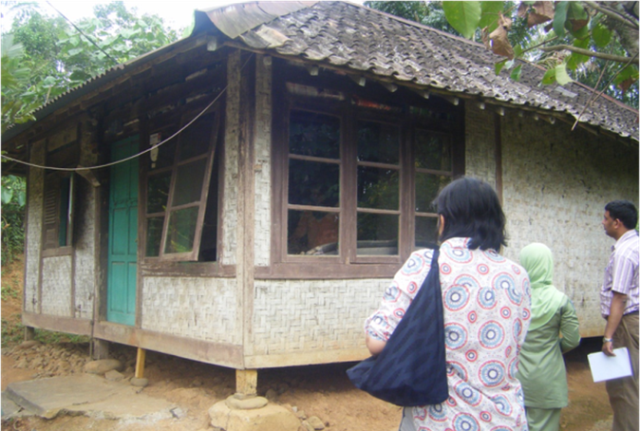
Home Visit unique behavior
Determine three of PD’s family
Determine two of PD’s family
Visit their homes
Conduct interviews and observations
Source: PDRC UI

Slide 7
Review
Tahap yang harus dilewati
Diskusi kelompok → perilaku umum
Perilaku unik tidak akan ditemukan jika tidak diketahui perilaku umum
Kunjungan rumah → perilaku unik
Dilakukan kunjungan rumah pada keluarga PD dan Non PD
Tugas
Tentukan aspek yang akan diselidiki berdasar skenario
Dokumentasi oleh PDRC FKM UI

Slide 8
Reference
Kurikulum dan Modul
Kegiatan Praktik Perilaku dan Pemulihan Gizi Melalui Pendekatan Positive Deviance

Slide 9
VIDEO BANTUAN DANA MATA KULIAH MOOCs DPASDP UI 2020
Copyright @ Universitas Indonesia 2020
Produksi S1 Gizi, FKM UI

