Slide 2
HOME VISIT (POSITIVE DEVIANCE INQUIRY)
Positive Deviance- 10th session
Trini Sudiarti
Department of Public Health Nutrition
Faculty of Public Health
Universitas Indonesia
2020
SOURCE : FREEPIK

Slide 3
OUT LINE
01
02
03
04
PROCEDURE OF HOME VISIT (PDI)
LOCATION AND TIME
TASK OF FASILITATOR WRITER OBSERVER
CRITERIA OF PARTISIPANTS

Slide 4
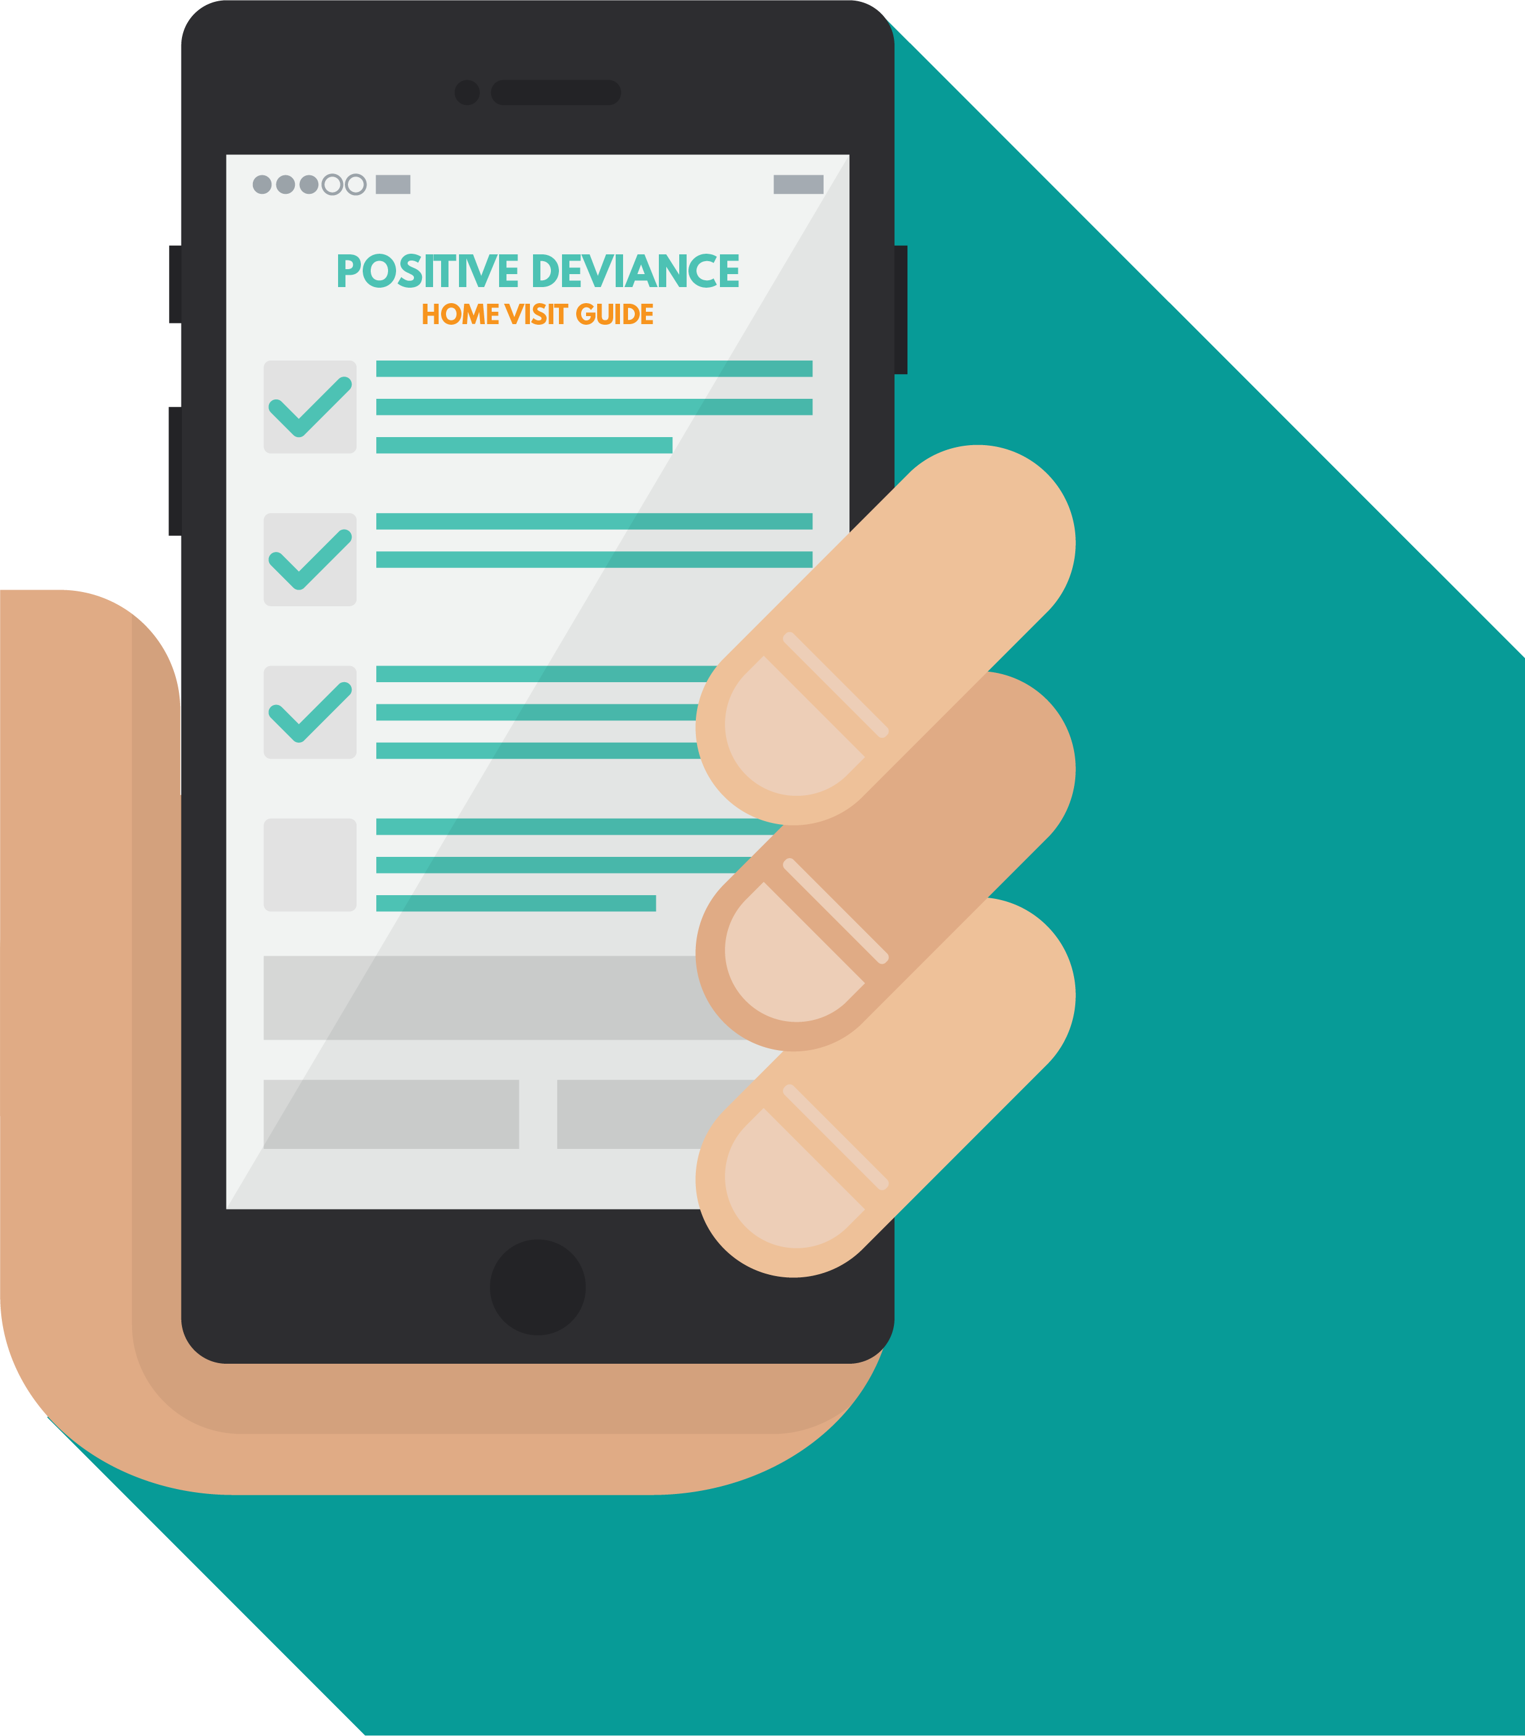
INTRODUCTION
What does mean positive deviance inquiry ?
How to find various unique behaviors and different strategies from poor families who have well-nourished toddler .
Positive deviance inquiry using the home visit methode based on open questions and observations.
They study the positive unique habits and strategies practiced by family positive deviance families that affect the nutritional status and health children under five.

Slide 5
METHOD OF HOME VISIT
Introduction
Interviews and Overservation
Report The Findings and Ask For Leave
Team acquaintance with family member
Explain the purpose & and duration of visit
Interviews with mother & family
Record and observe
Write a summary of the interview results
Ask for leave and thanks

Slide 6
LOCATION AND TIME
VENUE
TIME
Time of family cooking
Time of family feeding
Time of family playing
2-4 HOURS
Home of PD Family
Home of Non - PD Family
Collaboration with cadre
Interviewer, Writer, Observer

Slide 7
TASK OF TEAM
FACILITATOR
WRITER
OBSERVER
Understanding guide question
Using simple language
open asking 4 W + 1 H
Probing
Arrange the interviewing
Understanding guide guestionaire
Recording all the answer
Identifying unique positive behaviors
Remembering the interviewer
Observing the process interview and environment
Helping the facilitator
Keeping the interview

Slide 8
CRITERIA OF FAMILY PD AND NON-PD
FAMILY OF PD 3-4 Families
FAMILY OF NON-PD 2 Families
Have more one child nourished
Have children more 12 months
The child not the fisrst children
Poor family
Have under wave children of underweight
Rich family

Slide 9
PREPARATION OF HOME VISIT
Questionnaire and form of observation for guiding to ask when home visit and focus to inquiry behaviors of unique .
Interviewer bring the notes of general
behaviors result of focus group discussion for
deep quarriying.
Interviewer used simple language or local language.

Slide 10
STEP OF HOME VISIT (PDI)
CLOSING
ESTABLISHING THE MOOD
INTERVIEW
1
2
3
Introduction
Explaining home visit.
Asking for activities
Making interactions
Interview the mother
Open question about behaviors and probing
Family history, financial situation, expectation
Record interviewee
Observation the process and environment
Closing and apologize

Slide 11
CONCLUSSION
REFERENCES
Home visit useful to get unique positive behaviors from PD family by interviewer with mom or the family and observation the environment of the children.
The target home visit family PD or non-PD who have children over one years.
Bungin B. 2003. Analisis Data Penelitian Kualitatif. PT. Raja Grafindo Perkasa.
Depkes, Save The Children, Positive Deviance Resource Centre FKM UI. 2008. Kurikulum dan Modul ”KP3G Melalui Pendekatan Positive Deviance”.USAID , Save The Children, PDRC FKM UI.

Slide 12
DPASDP UI Grant
Copyright © Universitas Indonesia 2020
Department of Public Health Nutrition
Faculty of Public Health
Source : Gema Handaru

