Slide 2
POSITIVE DEVIANCE APPROACH IN NUTRITION 5th session DETERMINE CONCEPT
Diah M. Utari
Department of Public Health Nutrition
Faculty of Public Health
Universitas Indonesia

Slide 3
STUDY OBJECTIVES
01
02
03
Check Posyandu’s data
Determine the poverty criteria
Determine the PD’s individuals

Slide 4
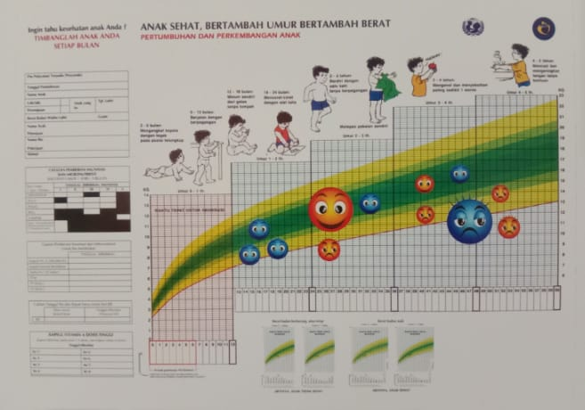
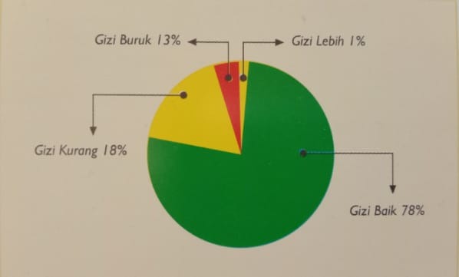
Check the posyandu's data
How many
children under five years .....??
Severe underweight
underweight
Normal
overweight
Sources Modul KP3G

Slide 5
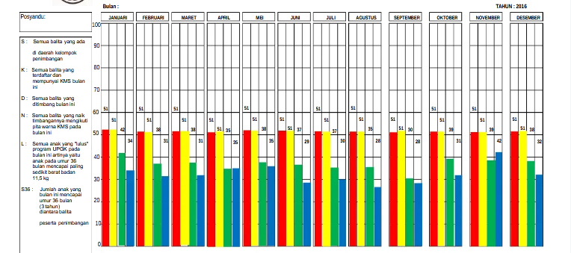
SKDN
SKDN
S = all of children under five years
K = children who have KMS
D = children who come to Posyandu
N = children who gain weight follow the KMS’s growth chart

Slide 6
Poverty criteria
Base on local criteria√ √ √
Each village has different poverty criteria → do not follow the national criteria or other criteria

Slide 7
PD individuals
Main criteria of PD individuals
Well nourished
Poor family
Dokumentasi oleh PDRC FKM UI

Slide 8
Added criteria of PD individual
Not the first child in family All of children in family are well nourished Living with parents Not getting regular help from other families
The more criteria they have, the bigger chance to be PD Individual candidate

Slide 9
REVIEW dan TUGAS
Cek Data Posyandu
Tentukan Kriteria Kemiskinan Lokal
Ciri Keluarga PD
Dari hasil penimbangan terakhir, buat daftar balita yang status gizi nya baik
Diskusikan bersama masyarakat setempat kriteria kemiskinan lokal
Jangan gunakan kriterina lain, karena belum tentu sesuai dengan kriteria kemiskinan lokal
Buat daftar keluarga yang tergolong miskin yang mempunyai balita
Keluarga miskin
Mempunyai balita gizi baik
Memenuhi kriteria tambahan yang ditetapkan
Tentukan Determine dalam skenario

Slide 10
Reference
Kurikulum dan Modul
Kegiatan Praktik Perilaku dan Pemulihan Gizi Melalui Pendekatan Positive Deviance

Slide 11
VIDEO BANTUAN DANA MATA KULIAH MOOCs DPASDP UI 2020
Copyright @ Universitas Indonesia 2020
Produksi S1 Gizi, FKM UI

