Slide 2
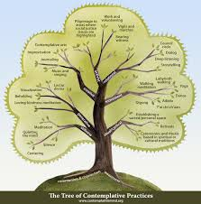
POSITIVE DEVIANCE APPROACH IN NUTRITION 11th session
Problem Tree and Questionnaire
Diah M. Utari
Department of Public Health Nutrition
Faculty of Public Health
Universitas Indonesia
http://clipart-library.com/discussion-cliparts.html

Slide 3
STUDY OBJECTIVES
01
02
Problem tree
Questionnaire

Slide 4
Problem trees are created to help find solutions by mapping cause and effect around the problem in a similar way to Mind maps, but with a lot more structure
Problem tree
01
The advantage of create a problem tree
The problem can be broken. This enables a clearer prioritisation of factors and helps focus objectives to create a question
The problem tree analysis be able to helps build a shared sense of understanding, purpose and action.
http://clipart-library.com/discussion-cliparts.html
https://www.odi.org/publications/5258-planning-tools-problem-tree-analysis

Slide 5
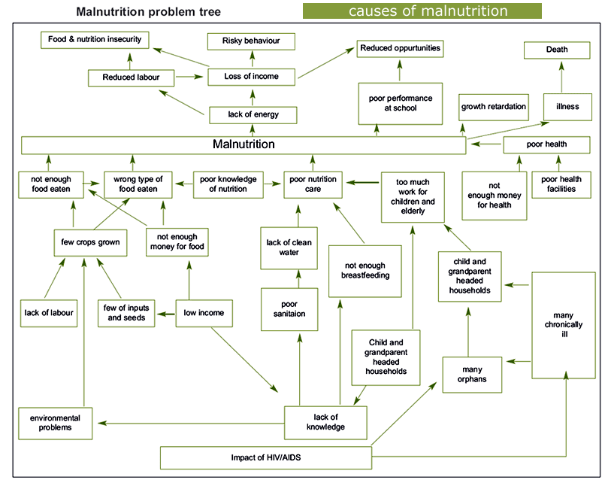
Example of a problem tree
http://motherchildnutrition.org/info/malnutrition-problem-tree.html

Slide 6
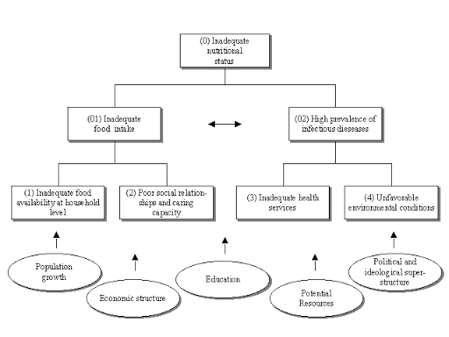
Example of a problem tree
http://www.nutrisurvey.de/baseline/part_32.htm

Slide 7
Questionnaire
02
Base on Problem Tree
Consumption
Hygiene
Health
Caring
Questionnaire

Slide 8
Open questions
Who, where, when, how many times
Consumption | Hygiene | Health | Caring
Stop breastfeeding | Washing hands with soap | immunization | Who’s caregiver
Complementary feeding | Where to defecate | Utilization of puskesmas | Children toys
Frequency of eating | Wearing footwear | Utilization of posyandu | Father’s involvement
Source of protein | Frequency of shower | Medication compliance | Quality time

Slide 9
Discussion create a questions for
malnutrition problems

Slide 10
Reference
Kurikulum dan Modul
Kegiatan Praktik Perilaku dan Pemulihan Gizi Melalui Pendekatan Positive Deviance

Slide 11
VIDEO BANTUAN DANA MATA KULIAH MOOCs DPASDP UI 2020
Copyright @ Universitas Indonesia 2020
Produksi S1 Gizi, FKM UI

