Slide 1
MK Bioengineering: (Biomaterials and Tissue Engineering)
Penanggung jawab:
Prof. dr. Jeanne Adiwinata, MS, PhD
Narasumber:
Muhammad Suhaeri, Ssi, MSc, PhD

Slide 2
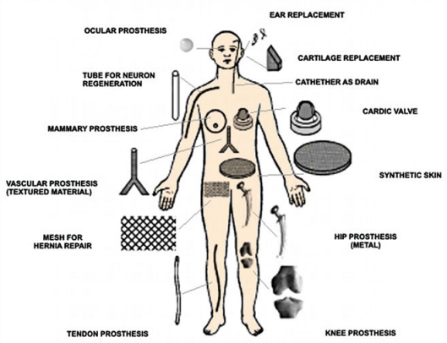
Definitions
Biomaterials
Any substance or combination of substances, other than drugs, synthetic or natural in origin, which can be used for any period of time, which augments or replaces partially or totally any tissue, organ or function of the body, in order to maintain or improve the quality of life of the individual.
Materials intended to interact with living system.

Slide 3
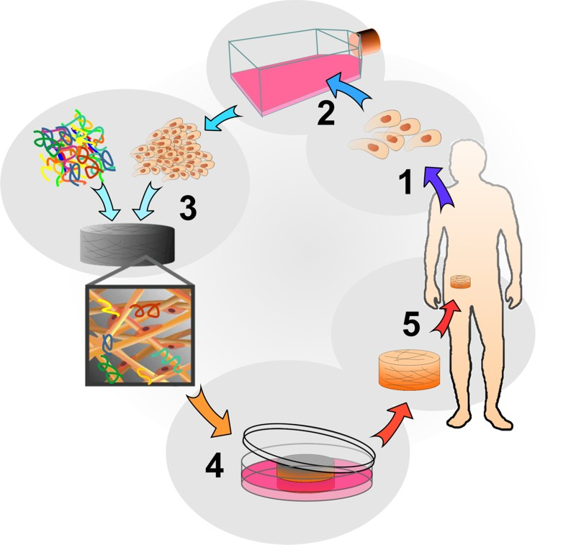
Definitions (2)
Tissue engineering
An interdisciplinary field that applies the principles of engineering and life sciences toward the development of biological substitutes that restore, maintain, or improve tissue function.
The creation of tissue construct.

Slide 4
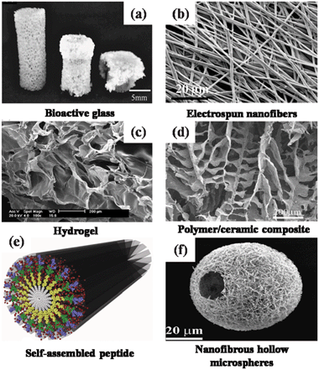
Scaffolds
Temporary or permanent artificial extracellular matrices to accommodate cells and support 3D tissue regenerations.
Scaffold definition and its various shapes.

Slide 5
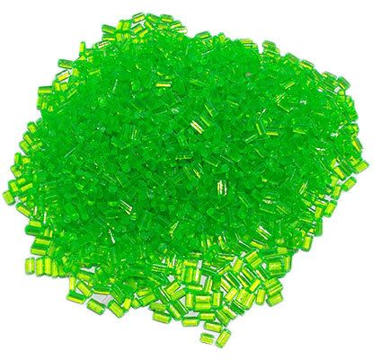
Scaffolds (2)
Natural
Collagen
Gelatin
Elastin
Fibrinogen
Silk
Chitosan
Synthetic
Poly(glycolic acid)
Poly(lactic acid)
Poly(lactide-Co-glycolide)
Polydioxanone
Polycaprolactone
The origin of scaffolds.

Slide 6
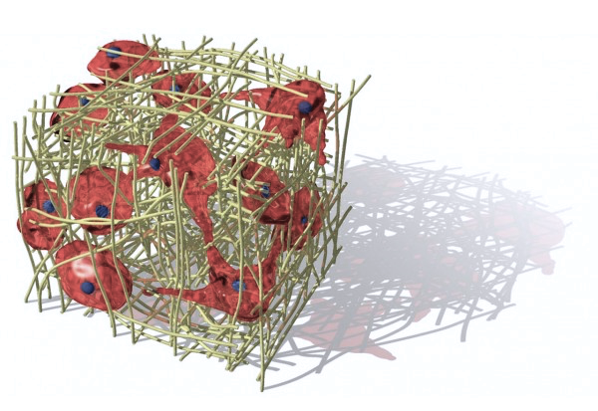
List of Content
Biomaterials and tissue engineering
Scaffolds
Cell culture

Slide 7
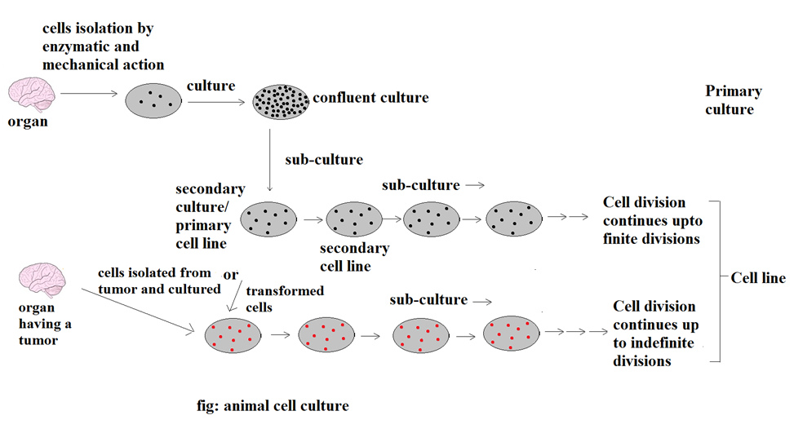
Primary culture and cell line
The difference of primary culture and cell line.

Slide 8
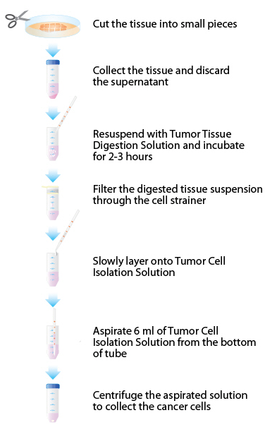
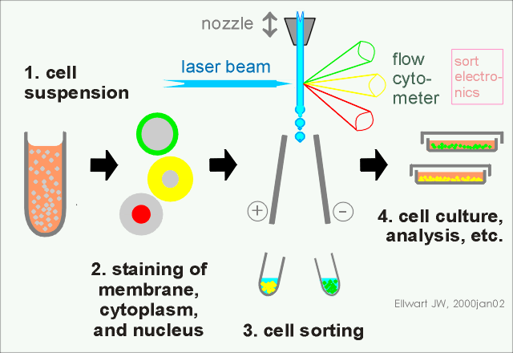
Cell isolation and sorting
Isolating cells and sorting them.

Slide 9
Adherent vs suspension cell culture

Slide 10
Cell differentiation
Definition of cell differentiation.

Slide 11
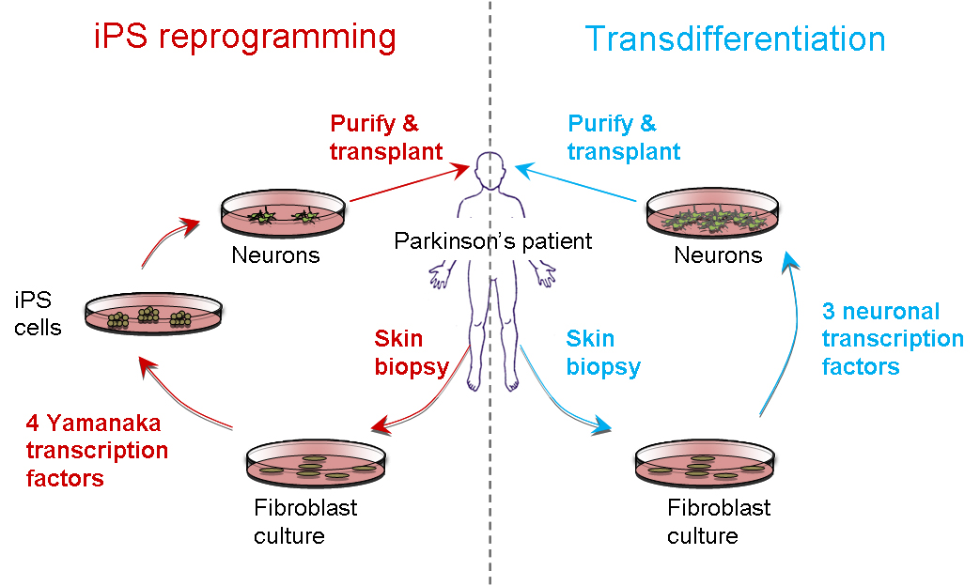
Transdifferentiation
Differentiated cells transformed into other type of differentiated cells.

Slide 12
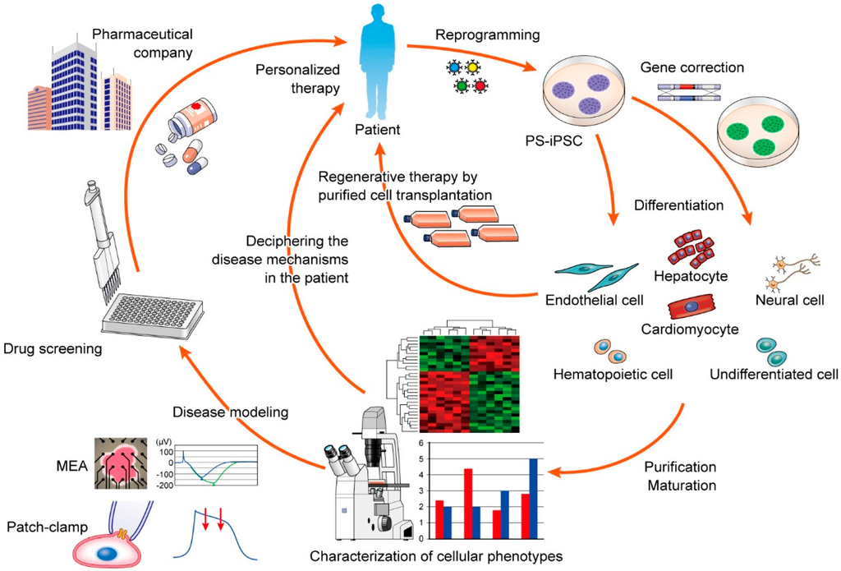
Summary of tissue engineering

