Slide 1
MK Bioengineering Bioinstrumentation & Biosensors For Tissue Engineering
Prasandhya Astagiri Yusuf, S.Si., M.T., Ph.D.
Department of Medical Physics
Faculty of Medicine Universitas Indonesia

Slide 2
Table of Contents
1
4
Biosensors
Immunosensors
2
5
Bioreceptors
Bioreactors
3
6
Biotransducer
Organs on Chips

Slide 3
Biosensors - Introduction
Biosensor
A self-contained analytical device that combines a biological component with a physicochemical component for the detection or quantification of an analyte of biological importance
Molecule
Receptor
Transducer
Electric
Signal
Bioreceptor
Detector
Transducer
Output
Biological (blood, urine, saliva)
Enviromental (water, air, soil)
Bioreceptor (nucleic acid, cells, antibody, enzyme)
Electrical Interface (nanowire array, nanoparticles, electrode)
Signal Amplifier
Signal Processor
Display

Slide 4
Bioreceptors / Biosensing Components
Molecule
Receptor
Transducer
Electric
Signal
Catalytic Type
Enzymes
Microbes
Organelles
Cells or Tissues
Affinity Type
Antibodies
Receptors
Nucleic Acids
Electrochemical
Optical
Magnetic
Acoustic
Calorimetric
Piezoelectric

Slide 5
Biotransducer in Immunosensor
Kubicek-Sutherland et al 2017 Biosensors

Slide 6
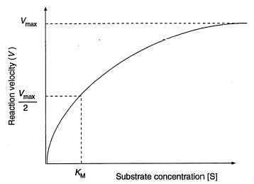
Enzymatic Biosensors
Substrate: the target molecule of an enzymatic reaction
Enzymes are catalysts for biochemical reactions; large macromolecules consisting mostly of protein, and usually containing a prosthetic group (metals)
Usually proteins of oxidase type that can selectively react with specific analytes, consume dissolved O₂ , and produce H₂ O₂ that is an easily detectable compound
S + E ES E+P
S: substrate; E: enzyme;
ES: enzyme-substrate complex;
P: product
Reaction rate vs. substrate concentration at constant enzyme concentration

Slide 7
Immunosensors
Immunosensors: based on highly specific antigen-antibody reactions
Detection of the reaction (binding/association) can be either direct or indirect (labeled)
ELISA: Competitive & Sandwich ELISA
Antigen-binding sites
Light chain
Fab region
Hinge region
Heavy chain
Fc region

Slide 8
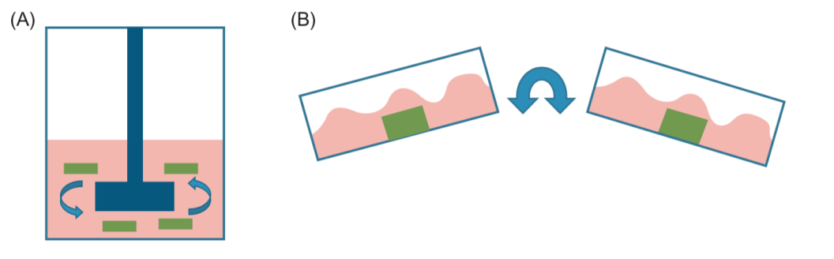
Tissue Engineering Bioreactors
Tissue engineering bioreactors are in vitro cell culture systems that have been designed to alter the following basic physiological phenomena: cell survival along with tissue structure, organization, and function
They can deliver both a productive three-dimensional culture environment and instructive stimuli
Mixing Bioreactors
Also known as dynamic culture bioreactors, supplying nutrients and removing waste by consistently circulating the media, whether through stirring, rocking, or perfusion
→ Allow for convection instead of relying on diffusion in static cell culture
Perfusion across
the surface of a construct
Perfusion through a construct
Rocker platform
Spinner flask
Blose et al. 2013

Slide 9
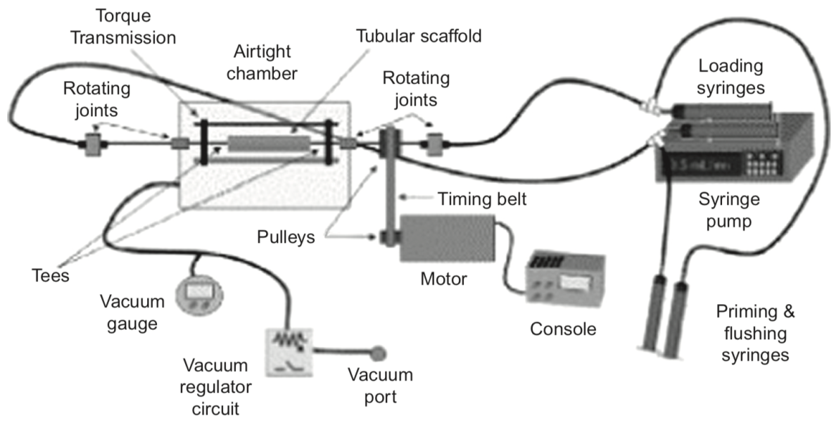
Cell Seeding Bioreactors
A secondary function of bioreactors is to distribute cells optimally throughout a scaffold prior to long-term culture
Vacuums, electromagnetism, and acoustic waves force cells to distribute throughout the thickness of scaffolds
Rotation can be used to help achieve a more uniform circumferential distribution and overcome the effects of settling from gravity
Blose et al. 2013

Slide 10
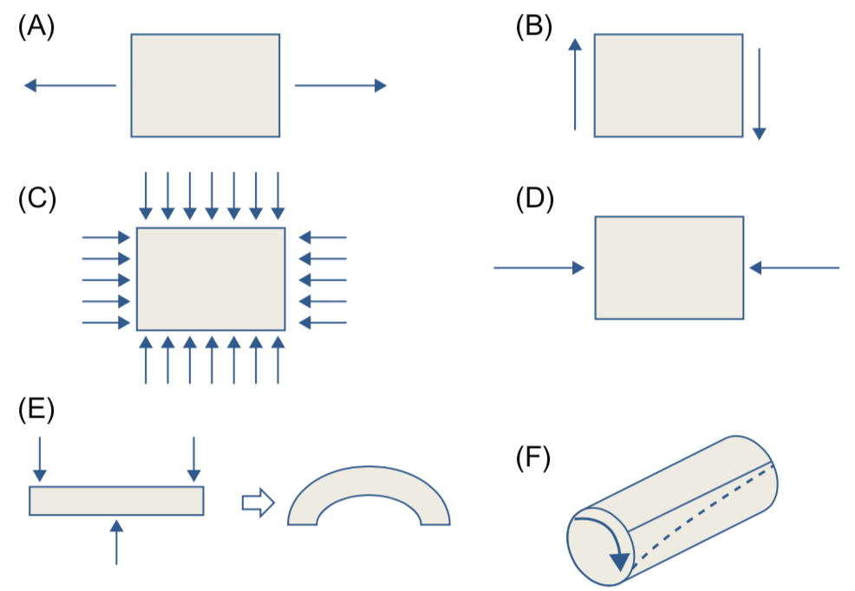
Guiding Tissue Structure and Function
Chemical stimulation
Represents a large variety of bioactive factors including growth factors, hormones, and chemical additives, which are added to the cell culture media to induce effects, such as proliferation or differentiation.
Mechanical stimulation
Though many complex loading patterns can exist within the body, most loading patterns used in bioreactors can be described simply through some combination of following:
Stretch
Shear
Pressure
Compression
Bending
Torsion

Slide 11
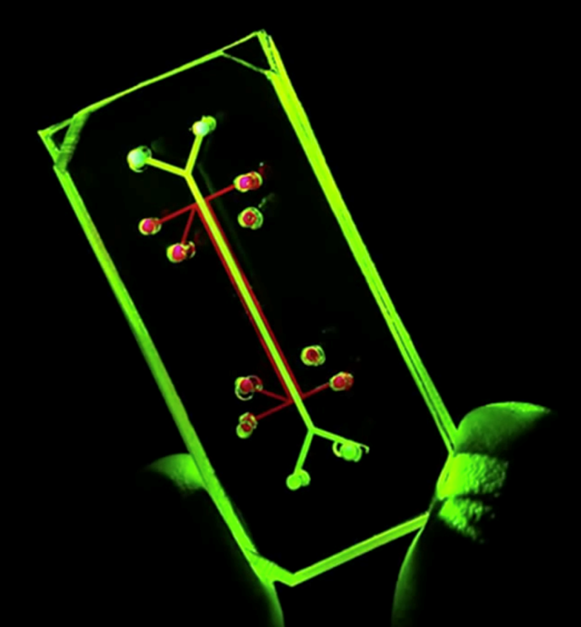
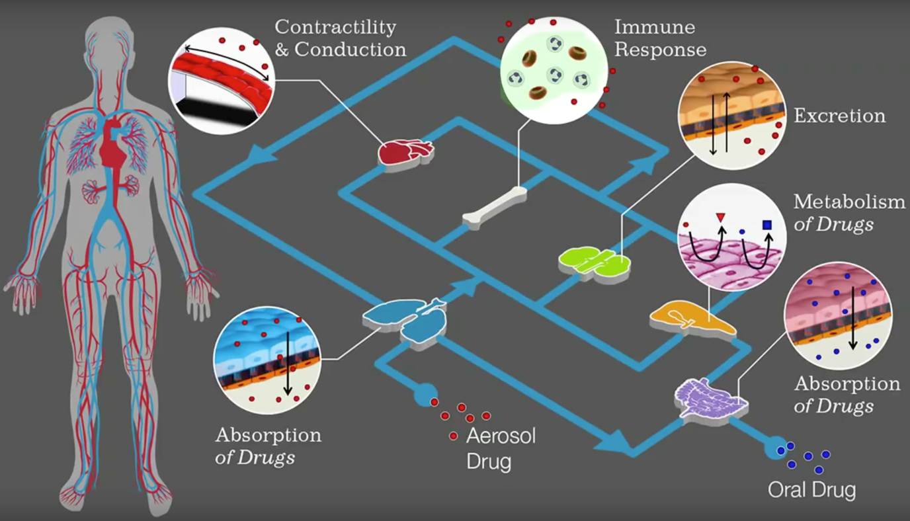
Organs On Chips

