Slide 1
Foundations of Programming 2: Exceptions
FoP 2 Teaching Team, Faculty of Computer Science, Universitas Indonesia Correspondence: Fariz Darari (fariz@cs.ui.ac.id)
Feel free to use, reuse, and share this work: the more we share, the more we have!
Notes:
https://unsplash.com/photos/KmKZV8pso-s

Slide 2
[ Handle mistakes, in an elegant way ]
Notes:
https://unsplash.com/photos/Odc4dcsjUBw

Slide 3
Why?
Despite all the efforts,
our code might still throw problems (= exceptions).
Are we going to let our program crash?
Notes:
Not necessarily our fault, users might throw in any wrong values in our program input.

Slide 4
Why?
Despite all the efforts,
our code might still throw problems (= exceptions).
Are we going to let our program crash?
Of course not!

Slide 5
What's the matter?
System.out.println(5/0);

Slide 6
What's the matter?
System.out.println(5/0);
Exception in thread "main" java.lang.ArithmeticException: / by zero
Notes:
Exception object with the following structure:
- Exception class: ArithmeticException
- Exception message: / by zero

Slide 7
What's the matter?
System.out.println("Ashhhiaaaaapp!".charAt(100));

Slide 8
What's the matter?
System.out.println("Ashhhiaaaaapp!".charAt(100));
Exception in thread "main"
negeri.+62.AlayException
Notes:
Sadly, it's an exception that can never be caught by the 'code' itself :(

Slide 9
What's the matter?
System.out.println("Ashhhiaaaaapp!".charAt(100));
Exception in thread "main"
java.lang.StringIndexOutOfBoundsException: String index out of range: 100

Slide 10
Quiz time: Make two exceptions!
Notes:
Make = throw

Slide 11
Quiz time: Make two exceptions!
List<String> l = null; l.isEmpty();

Slide 12
Quiz time: Make two exceptions!
List<String> l = null; l.isEmpty();
Exception in thread "main" java.lang.NullPointerException

Slide 13
Quiz time: Make two exceptions!
List<String> l = null; l.isEmpty();
Exception in thread "main" java.lang.NullPointerException
int[] arr = new int[-5];
Notes:
Infinite recursion: Exception in thread "main" java.lang.StackOverflowError

Slide 14
Quiz time: Make two exceptions!
List<String> l = null; l.isEmpty();
Exception in thread "main" java.lang.NullPointerException
int[] arr = new int[-5];
Exception in thread "main" java.lang.NegativeArraySizeException: -5
Notes:
Infinite recursion: Exception in thread "main" java.lang.StackOverflowError

Slide 15
Quiz time: Can you create a code throwing java.lang.StackOverflowError?
Notes:
Infinite recursion: Exception in thread "main" java.lang.StackOverflowError

Slide 16
Quiz time: Can you create a code throwing java.lang.StackOverflowError?
Calling f() when f() is defined as below:
public static void f() {
f();
}
Notes:
Infinite recursion: Exception in thread "main" java.lang.StackOverflowError

Slide 17
About exceptions
The ideal time to catch an error is at compile time.
However, not all errors can be detected at compile time.
Improved error recovery is one of the most powerful ways to increase the robustness of your code.
To create a robust system, each component must be robust.
By providing an error-reporting model using exceptions, Java allows components to reliably communicate problems to client code.

Slide 18
Flow of code execution
Normal main sequential code execution, the program doing what it meant to accomplish.
Exception handling code execution, the main program flow was interrupted by an error or some other condition that prevent the continuation of the normal main sequential code execution.

Slide 19
Division code: Can you break this code?
public class SimpleDivisionOperation {
public static void main(String[] args) {
System.out.println(divide(4, 2));
if (args.length > 1) {
int arg0 = Integer.parseInt(args[0]);
int arg1 = Integer.parseInt(args[1]);
System.out.println(divide(arg0, arg1));
}
}
public static int divide(int a, int b) {
return a / b;
}
}

Slide 20
Division by zero
The program defines a method divide that does a simple division.
It can safely be assumed that when the divide(4, 2) statement is called, it would return the number 2.
However, consider the next statement, where the program relies upon the provided command line arguments to generate a division operation. What if the user provides the number zero (0) as the second argument?
Notes:
We all know that division by zero is impossible, but the compiler couldn't possibly have anticipated the user providing zero as an argument.

Slide 21
Division by zero

Slide 22
Division by zero
The stack trace in the above example tells us more about the error, such as:
the thread — "main" — where the exception occurred,
the type of exception — java.lang.ArithmeticException,
a readable display message — / by zero, and
the exact methods and the line numbers where the exception occurred.
Notes:
Such exceptional code that results in erroneous interpretations at program runtime usually results in errors that are called exceptions in Java. When the Java interpreter encounters an exceptional code, it halts execution and displays information about the error that occurs. This information is known as a stack trace. The stack trace in the above example tells us more about the error, such as the thread — "main" — where the exception occurred, the type of exception — java.lang.ArithmeticException, a comprehensible display message — / by zero, and the exact methods and the line numbers where the exception may have occurred.
error happens at (from top): main (line 7) -> divide (line 12)

Slide 23
Throwing an exception object explicitly
public class SimpleDivisionOperation {
// ...
public static int divide(int a, int b) {
if (b == 0) {
throw new ArithmeticException("OMG!");
} else {
return a / b;
}
}
}
Notes:
Try it out!
Note that when b equals zero, there is no return value. Instead of a java.lang.ArithmeticException generated by the Java interpreter itself, it is an exception created by the coder. The result is the same. It shows you that an exception is an object. Its main particularity is that it can be thrown. An exception object must inherit from java.lang.Exception.

Slide 24
Standard exceptions have two constructors
Notes:
Above: Default constructor
Below: Passing string for exception message

Slide 25
try/catch statement
By default, when an exception is thrown,
the current method is interrupted, the calling method is interrupted too and so on till the main method.
A thrown exception can also be caught using a try/catch statement.

Slide 26
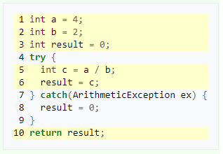
try/catch statement: code
Notes:
The executed code lines have been highlighted. When no exception is thrown, the method flow executes the try statement and not the catch statement.

Slide 27
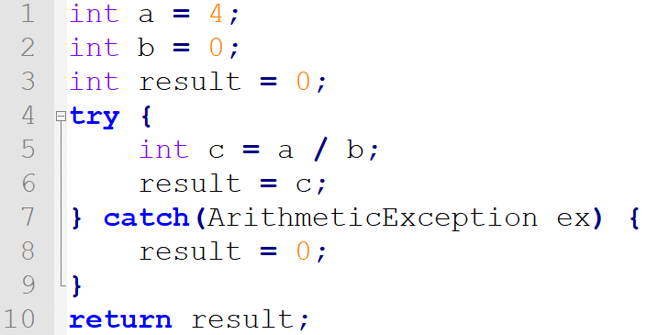
Quiz time: Which code lines are executed when b = 0?
Notes:
The executed code lines have been highlighted. When no exception is thrown, the method flow executes the try statement and not the catch statement.

Slide 28
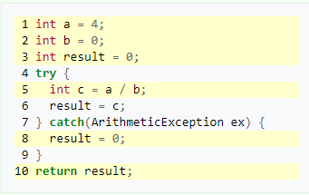
Solution
Notes:
As there is a thrown exception at line 5, the line 6 is not executed, but the exception is caught by the catch statement so the catch block is executed. The following code is also executed. Note that the catch statement takes an exception as parameter.

Slide 29
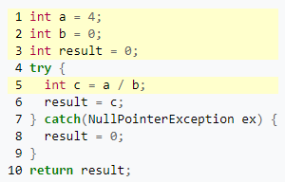
What's going on here?
Notes:
There is a third case: when the exception is not from the same class as the parameter.
It is as if there is no try/catch statement. The exception is thrown to the calling method.

Slide 30
catch blocks
A try/catch statement can contain several catch blocks, to handle different exceptions in different ways.
An exception object may match several catch block but only the first catch block that matches the object will be executed.
A catch-block will catch a thrown exception if and only if:
the thrown exception object is the same as the exception object specified by the catch-block.
the thrown exception object is the subtype of the exception object specified by the catch-block.

Slide 31
Quiz time: Fix this using exception handling
// .. inside main method
System.out.println(Integer.parseInt("tahu apa yang paling bikin sakit? tahu kamu sudah ada yang punya T_T"));
System.out.println("Cetak aku pls");

Slide 32
Solution
// .. inside main method
try {
System.out.println(Integer.parseInt("tahu apa yang paling bikin sakit? tahu kamu sudah ada yang punya T_T"));
} catch(java.lang.NumberFormatException ex) {
System.out.println("Value tidak benar");
}
System.out.println("Cetak aku pls");

Slide 33
Quiz time: Can you fix this?
public class Exercise {
public static void main(String[] args) {
try {
System.out.print(2/0);
}
catch(Exception e) { }
catch(ArithmeticException e) { }
}
}
Notes:
The code won't even compile!
Unreachable catch block for ArithmeticException. It is already handled by the catch block for Exception. The order must be swapped!

Slide 34
finally block
A finally block can be added after the catch blocks.
A finally block is always executed, even when no exception is thrown, an exception is thrown and caught, or an exception is thrown and not caught.
It's a place to put code that should always be executed after an unsafe operation like a file close or a database disconnection.
You can define a try block without catch block, however, in this case, it must be followed by a finally block.

Slide 35
Quiz time: What's the output?
public class Exercise {
public static void main(String[] args) {
try {
System.out.print(2/0);
}
catch(ArithmeticException e) {
System.out.print("A");
}
finally {
System.out.print("B");
}
}
}
Notes:
AB

Slide 36
Quiz time: What's the output?
public class Exercise {
public static void main(String[] args) {
try {
System.out.print(2/1);
}
catch(ArithmeticException e) {
System.out.print("A");
}
finally {
System.out.print("B");
}
}
}
Notes:
2B

Slide 37
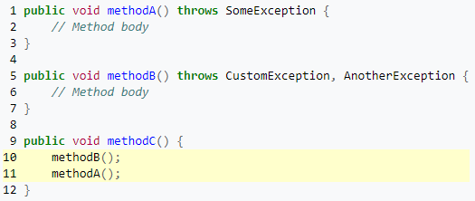
Example of handling exceptions: oops
Notes:
In the code, methodC is invalid. Because methodA and methodB pass (or throw) exceptions, methodC must be prepared to handle them.
This can be handled in two ways:
a try-catch block, which will handle the exception within the method; and
a throws clause which would in turn throw the exception to the caller to handle.
The above example will cause a compilation error, as Java is very strict about exception handling. So the programmer is forced to handle any possible error condition at some point.
A method can do two things with an exception: ask the calling method to handle it by the throws declaration or handle the exception inside the method by the try-catch block.

Slide 38
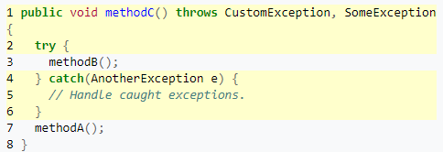
Example of handling exceptions
Notes:
The AnotherException from methodB will be handled locally, while CustomException and SomeException will be thrown to the caller to handle it. Most of the developers are embarrassed when they have to choose between the two options. This type of decision should not be taken at development time. If you are a development team, it should be discussed between all the developers in order to have a common exception handling policy.

Slide 39
NullPointerException
In Java, a special null value can be assigned to an object reference. NullPointerException is thrown when an application attempts to use an object reference that has the null value. These include:
Calling an instance method on the object referred by a null reference.
Accessing or modifying an instance field of the object referred by a null reference.
If the reference type is an array type, taking the length of a null reference.
If the reference type is an array type, accessing or modifying the slots of a null reference.

Slide 40
Quiz time: What can go wrong, and how to fix it?
Notes:
If the object is null, it does not just do zero loops, it throws a null pointer exception. So don't forget this case. Add an if statement or return empty collections:

Slide 41
Quiz time: What can go wrong? Fixed!

Slide 42
Quiz time: What can go wrong? Fixed too!
Collection<Integer> myNumbers = buildNumbers();
try {
for(Integer myNumber:myNumbers) {
System.out.println(myNumber);
}
} catch(NullPointerException e) {
System.out.println("The collection is empty!");
}

Slide 43
Stack trace
A Stack Trace is a list of method calls from the point when the application was started to the current location of execution within the program.
A Stack Trace is produced automatically by the Java Virtual Machine when an exception is thrown to indicate the location and progression of the program up to the point of the exception.
The most recent method calls are at the top of the list.

Slide 44
Stack trace
public class StackTraceExample {
public static void main(String[] args) {
method1();
}
public static void method1() {
method11();
}
public static void method11() {
method111();
}
public static void method111() {
throw new NullPointerException("Fictitious NullPointerException");
} }

Slide 45
Stack trace

Slide 46
Checked vs. Unchecked Exceptions
A checked exception is a type of exception that must be either caught or declared in the method in which it is thrown. For example, the java.io.IOException is a checked exception. It extends java.lang.Exception.
Unchecked, uncaught, or runtime exceptions are exceptions that can be thrown without being caught or declared. They extend java.lang.RuntimeException.

Slide 47
Checked Exception
public static void main(String[] args) {
ioOperation(true);
}
public static void ioOperation(boolean isResourceAvailable) throws IOException {
if (!isResourceAvailable) {
throw new IOException();
}
}
A checked exception is a type of exception that must be either caught or declared in the method in which it is thrown. The code above won't compile: Unhandled exception type IOException

Slide 48
Checked Exception
public static void main(String[] args) {
try {
ioOperation(true);
} catch(IOException e) {
System.out.println("IO Error");
}
public static void ioOperation(boolean isResourceAvailable) throws IOException {
if (!isResourceAvailable) {
throw new IOException();
}
}
A checked exception is a type of exception that must be either caught or declared in the method in which it is thrown. The code above won't compile: Unhandled exception type IOException
A checked exception must always be enclosed with try-catch (or add throws).

Slide 49
Unchecked Exception
public static void main(String[] args) {
someOperation();
}
public static void someOperation() {
List<String> l = null;
l.isEmpty();
}
An unchecked exception does not need to be caught or thrown.

Slide 50
Make your own exception
// OwnException.java
public class OwnException extends Exception {
public OwnException(String errorMsg) {
super(errorMsg);
}
}

Slide 51
Make your own exception
// Exercise.java
public class Exercise {
public static void main(String[] args) {
try {
someMethod(5);
} catch(OwnException e) {
System.out.println(e.getMessage());
}
}
public static void someMethod(int i) throws OwnException {
if(i > 0)
throw new OwnException("Ouch!");
}
}

Slide 52
Quiztime: Make an exception class, and throw it whenever age < 18 in the method checkAge(int age).
Notes:
Solution follows previous one.

Slide 53
Inspired by: https://en.wikibooks.org/wiki/Java_Programming Liang. Introduction to Java Programming. Tenth Edition. Pearson 2015. Think Java book by Allen Downey and Chris Mayfield. Eck. Introduction to Programming Using Java. 2014.
Notes:
Picture: https://unsplash.com/photos/VyC0YSFRDTU

