Slide 1
Dasar-Dasar Pemrograman 2: Java Conditions and Loops
Fariz Darari (fariz@cs.ui.ac.id)
Feel free to use, reuse, and share this work: the more we share, the more we have!
Notes:
Credit: https://www.pexels.com/photo/black-and-white-roller-coaster-106155/

Slide 2
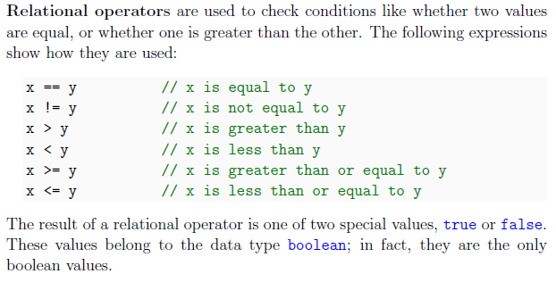
Relational operators

Slide 3
Java has three logical operators
&& that is used for and
|| that is used for or
! that is used for not

Slide 4
Examples

Slide 5
De Morgan's laws

Slide 6
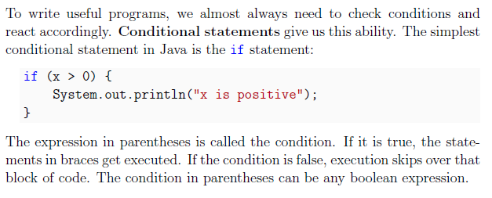
Conditions

Slide 7
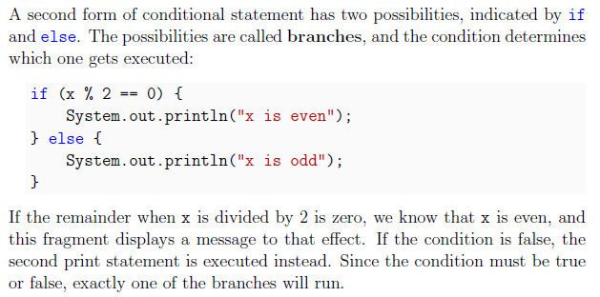
if and else

Slide 8
Quiz time: What's wrong?

Slide 9
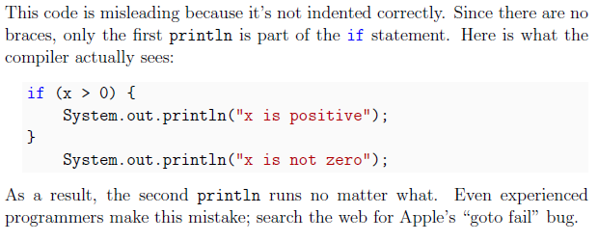
Quiz time: What's wrong?

Slide 10
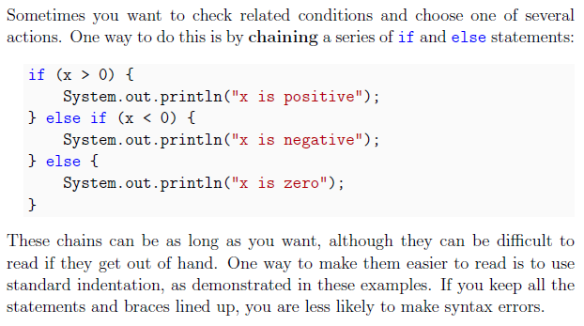
Chaining if and else

Slide 11
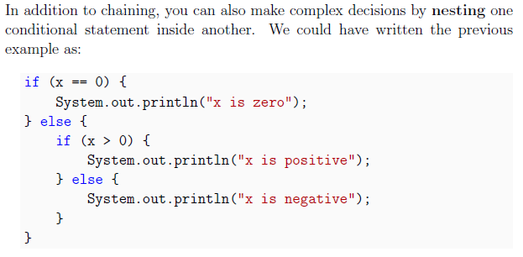
Nesting if and else

Slide 12
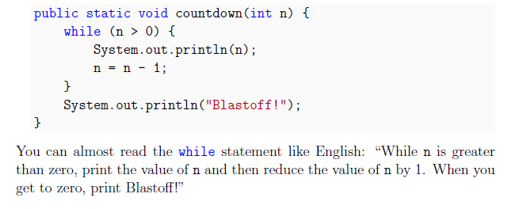
while loop

Slide 13
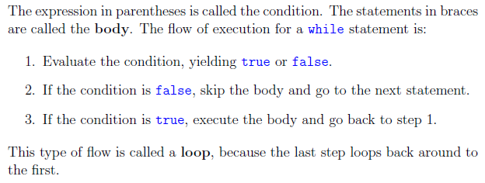
while loop

Slide 14
for loop
public static void countdown(int n) { for(int i = n; i > 0; i--) { System.out.println(i); } System.out.println("Blastoff!"); }

Slide 15
for loop

Slide 16
do-while loop
int i = 0; do { System.out.println("Hi!"); } while (i!=0);
Try run this, check if Hi! is still printed out or not

Slide 17
take a break
int i = 0; while(i < 6) { System.out.print(i); if(i == 3) break; i++; }
0123

Slide 18
switch to be a better person
Check this out too: https://docs.oracle.com/javase/tutorial/java/nutsandbolts/switch.html
String you = "good"; switch(you) { case "bad": you = "good"; break; case "good": you = "better"; break; default: you = "best"; } System.out.println(you);

Slide 19
Credits: Think Java book by Allen Downey and Chris Mayfield
Notes:
Picture: https://unsplash.com/photos/VyC0YSFRDTU

