Slide 1
CSGE601020 | Dasar-Dasar Pemrograman 1
Sistem Bilangan pada Komputer
Fariz Darari
Notes:
https://www.pexels.com/photo/black-and-white-chessboard-4874075/

Slide 2
What we see when using a computer
Notes:
Kita sering menggunakan komputer untuk mengetik tulisan (file teks), melihat gambar, atau menonton video.
https://www.iconfinder.com/iconsets/circle-icons-1

Slide 3
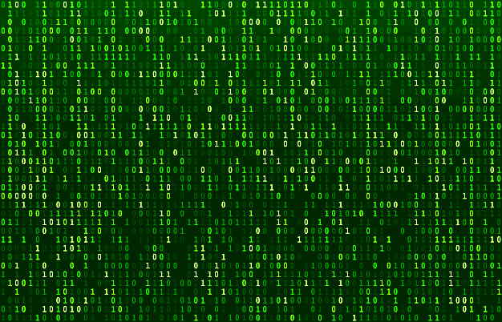
What is actually stored in a computer
Notes:
All computer data is represented using binary, a number system that uses 0s and 1s.
Why? The circuits in a computer's processor are made up of billions of transistors. A transistor is a tiny switch that is activated by the electronic signals it receives. The digits 1 and 0 used in binary reflect the on and off states of a transistor.
https://www.bbc.co.uk/bitesize/guides/zwsbwmn/revision/1
http://androidgrl.github.io/2019/01/01/binary/
https://www.freepik.com/premium-vector/matrix-code-stream-green-data-codes-screen-binary-numbers-flow-computer-encryption-row-screens-abstract_6286775.htm

Slide 4
A Snippet of ASCII Table
Notes:
ASCII is an acronym for American Standard Code for Information Interchange, a widely used standard for encoding text documents on computers. Usually, a file described as "ASCII" does not contain any special embedded control characters; you can view the contents of the file, change it with an editor, or print it with a printer.
In ASCII, every letter, number, and punctuation symbol has a corresponding number, or ASCII code. For example, the character for the number 1 has the code 49, capital letter A has the code 65, and a blank space has the code 32. This encoding system not only lets a computer store a document as a series of numbers, but also lets it share such documents with other computers that use the ASCII system.
Documentation files or program source code files are usually stored as ASCII text. In contrast, binary files, such as executable programs, graphical images, or word processing documents, contain other characters that cannot be normally displayed or printed, and are usually illegible to human beings.
The format of a file, whether ASCII or binary, becomes important when you are transferring files between computers. For example, when using FTP, you can transfer ASCII text files without any special consideration. To exchange binary files, however, you may need to enter the command set binary or otherwise prepare the client to transfer binary files, so that the computer will correctly transmit the special characters in the file.
https://kb.iu.edu/d/afht
https://commons.wikimedia.org/wiki/File:ASCII-Table.svg

Slide 5
Quiz time: Translate this binary code into text
1000001
1000100
1001001
Notes:
Permainan sandi (binary)

Slide 6
Quiz time: Translate this binary code into text
1000001
1000100
1001001
A
D
I

Slide 7
ASCII Table
Notes:
Tampilan lengkap, secara umum tanda baca, angka, huruf besar, huruf kecil
Salah satu standar pemetaan (encoding/decoding) untuk teks pada komputer.
https://commons.wikimedia.org/wiki/File:ASCII-Table.svg

Slide 8
Binary Numbers
Bilangan biner digunakan untuk merepresentasikan data pada komputer
Bilangan biner adalah bilangan yang memiliki basis dua: 0 dan 1
Sebagai catatan, bilangan yang biasa kita pakai adalah desimal, yang berbasis sepuluh: 0, 1, 2, 3, 4, 5, 6, 7, 8, 9
Notes:
https://en.wikipedia.org/wiki/Binary_number

Slide 9
From Binary to Decimal
Notes:
https://en.wikipedia.org/wiki/Binary_number

Slide 10
From Decimal to Binary
Notes:
https://www.geeksforgeeks.org/program-decimal-binary-conversion/

Slide 11
From Decimal to Binary
Notes:
https://www.geeksforgeeks.org/program-decimal-binary-conversion/

Slide 12
From Decimal to Binary
Notes:
https://www.geeksforgeeks.org/program-decimal-binary-conversion/

Slide 13
Octal and Hexadecimal Numbers
Jika bilangan biner berbasis dua, bilangan octal berbasis delapan: 0, 1, 2, 3, 4, 5, 6, 7
Bilangan octal dipakai pada pengaturan file permission pada Linux
Sementara itu, bilangan hexadecimal berbasis 16: 0, 1, 2, 3, 4, 5, 6, 7, 8, 9, A, B, C, D, E, F
Bilangan hexadecimal dipakai pada URL, alamat IPv6, serta kode warna pada HTML dan CSS

Slide 14
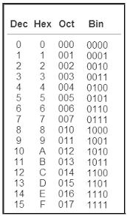
Octal and Hexadecimal Numbers
Notes:
https://arxiv.org/ftp/arxiv/papers/1107/1107.1663.pdf

Slide 15
Binary, octal, and hexadecimal in Python
# bin to dec
print(int(0b101))
# dec to bin
print(bin(5))
# oct to dec
print(int(0o101))
# dec to oct
print(oct(65))
# hex to dec
print(int(0x101))
# dec to hex
print(hex(257))

Slide 16
Thanks
and keep practicing!
Notes:
https://www.iconfinder.com/icons/4375050/logo_python_icon
https://www.iconfinder.com/icons/3099466/determined_face_icon

